Slide 1
Bioinformatics Lecture 1: Introduction
Course code : MDS 657
3 July 2025
Roji Raut

Slide 2

Before you begin:

Slide 3
Course Objectives
Understand basic concept of Molecular biology and biological data
Know different biological databases and tools to retrieve and analyze the relevant data
Perform pairwise and multiple sequence alignment and construct phylogenetic tree
Predict structure and function of protein
Use computational tools for genomic data
Gain knowledge in drug discovery and emerging fields in bioinformatics

Slide 4
Unit1: Introduction (8 hrs)
Overview, history, scope and application areas in bioinformatics, Major databases in bioinformatics, File formats, Molecular Biology, Central dogma of molecular biology, Information search and data retrieval tools (Entrez SRS), Data mining of biological data, Genome analysis, Genome mappings, Genome sequencing, Sequence assembly and annotation tools. Human Genome project.

Slide 5
What is Bioinformatics?
According to a National Institutes of Health (NIH) definition, bioinformatics is
“research, development, or application of computational tools and approaches for expanding the use of biological, medical, behavioral, or health data, including those to acquire, store, organize, analyze, or visualize such data.”
The related discipline of computational biology is “the development and application of data‐analytical and theoretical methods, mathematical modeling, and computational simulation techniques to the study of biological, behavioral, and social systems.”

Slide 6
What is Bioinformatics?
Another definition from the National Human Genome Research Institute (NHGRI) is that
“Bioinformatics is the branch of biology that is concerned with the acquisition, storage, display, and analysis of the information found in nucleic acid and protein sequence data.”
Russ Altman (1998) and Altman and Dugan (2003) offer two definitions of bioinformatics.
The first involves information flow following the central dogma of molecular biology.
The second definition involves information flow that is transferred based on scientific methods. This definition includes problems such as
designing, validating, and sharing software;
storing and sharing data;
performing reproducible research workflows;
interpreting experiments.

Slide 7
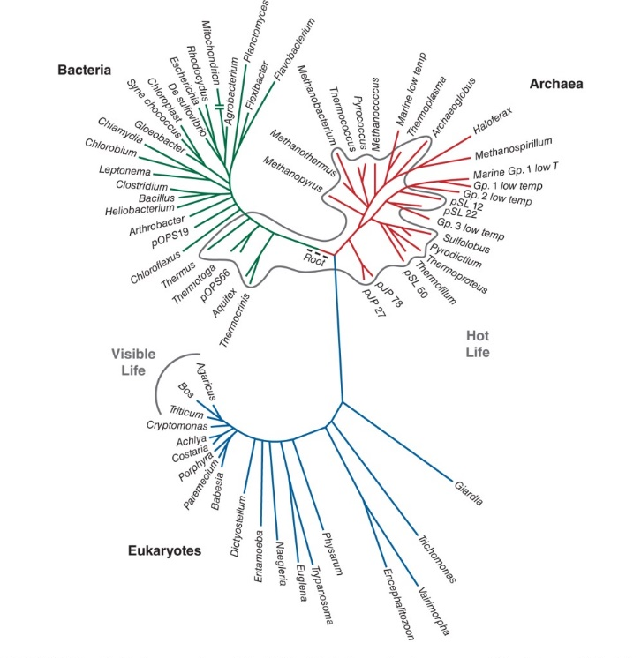
Introduction to Bioinformatics
3 perspectives
At the cellular level:
Study molecular data – sequence, structure, images etc.
At organismal level:
A Broadening our view from the level of the cell to the organism, we can consider the individual’s genome (collection of genes), including the genes that are expressed as RNA transcripts and the protein products.
For an individual organism, bioinformatics tools can therefore be applied to describe changes through developmental time, changes across body regions, and changes in a variety of physiological or pathological states.

Slide 8
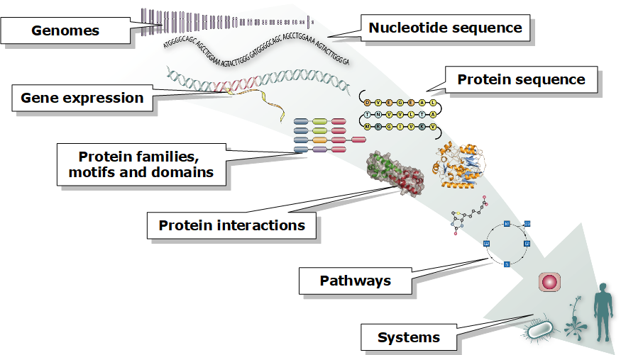
Introduction to Bioinformatics
At global level (the tree of life):
The scope of bioinformatics includes all of life on Earth, including the three major branches of bacteria, archaea, and eukaryotes.
For all species, the collection and analysis of molecular sequence data allow us to describe the complete collection of DNA that comprises each organism (the genome).
We can further learn the variations that occur between species and among members of a species, and we can deduce the evolutionary history of life on Earth.

Slide 9
Introduction to Bioinformatics
Bioinformatics is an interdisciplinary field that develops
Technologies that uses computers for storage, retrieval, manipulation & distribution of information related to biological macromolecules such as RNA, DNA and proteins.
It combines
computer science,
statistics,
mathematics,
engineering to analyze and interpret biological data
As a technology, bioinformatics is a powerful technology to manage, query, and analyze big data in life sciences.
As a methodology, bioinformatics is a top-down, holistic, data-driven, genome-wide, and systems approach that generates new hypothesis , finds new patterns, and discovers new functional elements.

Slide 10
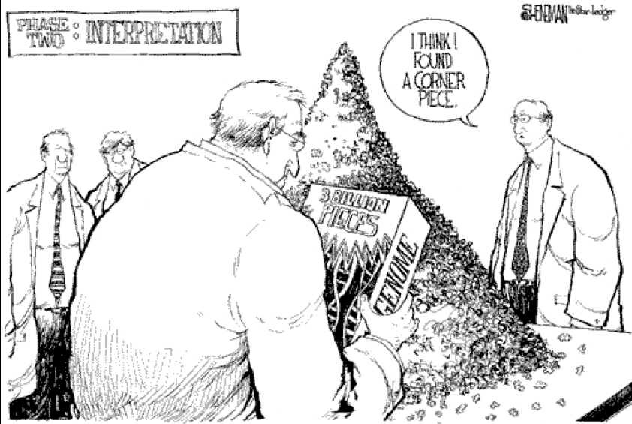
Goals of Bioinformatics
Due to this enormous amount of data, scientists have started contemplating new data driven goals:
to understand integrated aspects of the biology of organisms, viewed as coherent complex organizations, at microscopic and macroscopic levels;
to curate, annotate, and impose a structure on the available data, and to provide avenues for access and distribution;
to interrelate sequence, three-dimensional structure, expression pattern, interaction, and function of individual proteins, nucleic acids, and protein–nucleic acid complexes;

Slide 11
Goals of Bioinformatics
Due to this enormous amount of data, scientists have started contemplating new data driven goals:
to integrate the data on the different aspects of the life of a cell or organism into a ‘systems’ description of its structure and dynamics;
to use data on contemporary organisms as a basis for travel backward and forward in time: back to deduce events in evolutionary history, forward to achieve greater deliberate scientific modification of biological systems;
to support applications to medicine, agriculture, and technology.

Slide 12
Application of Bioinformatics
Use of this enormous amount of biological data can help us solve a variety of serious social problems:
Improvement of the health of humans, animals, and plants. Possible contributions include identifying lifestyles that prevent, or at least lower the risk of, disease, and treatment of illnesses when they do arise.
providing adequate nutrition to a growing population;
providing energy to run industries, transportation, communications, and personal appliances such as computers, telephones, music players, etc.;
development of novel materials;
guiding conservation efforts, especially the preservation of endangered species.

Slide 13
Computational approaches to biological problems
Using public databases and data formats
The first key skill for biologists is to learn to use online search tools to find information.
Literature searching is no longer a matter of looking up references in a printed index.
You can find links to most of the scientific publications you need online.
There are central databases that collect reference information so you can search dozens of journals at once.

Slide 14
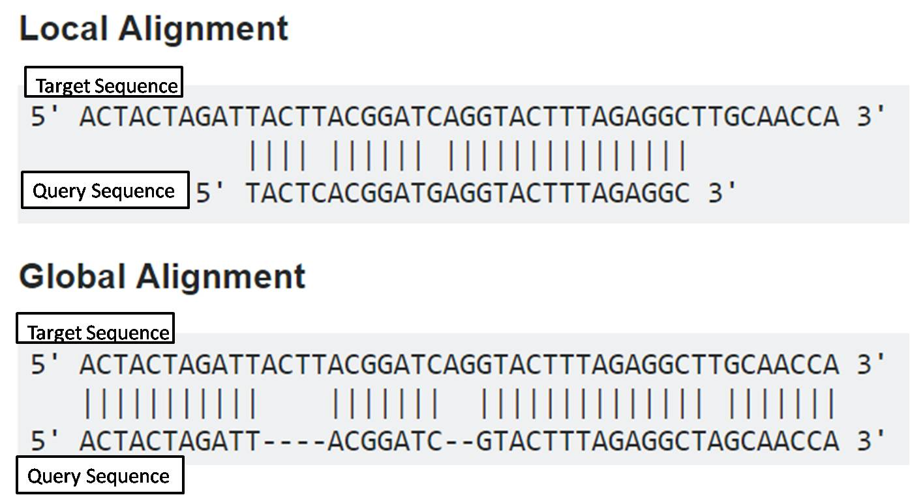
Computational approaches to biological problems
Sequence alignment and sequence searching
Being able to compare pairs of DNA or protein sequences and extract partial matches has made it possible to use a biological sequence as a database query.
Sequence-based searching is another key skill for biologists; a little exploration of the biological databases at the beginning of a project often saves a lot of valuable time in the lab.
Identifying homologous sequences provides a basis for phylogenetic analysis and sequence-pattern recognition.
Sequence-based searching can be done online through web forms, so it requires no special computing skills, but to judge the quality of your search results you need to understand how the underlying sequence-alignment method works and go beyond simple sequence alignment to other types of analysis.

Slide 15
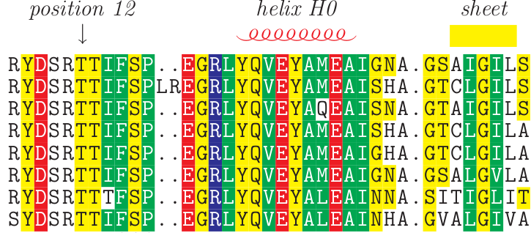
Computational approaches to biological problems
Multiple sequence alignment
Multiple sequence-alignment methods assemble pairwise sequence alignments for many related sequences into a picture of sequence homology among all members of a gene family.
Multiple sequence alignments aid in visual identification of sites in a DNA or protein sequence that may be functionally important. Such sites are usually conserved; that is, the same amino acid is present at that site in each one of a group of related sequences.
Multiple sequence alignments can also be quantitatively analyzed to extract information about a gene family.
Multiple sequence alignments are an integral step in phylogenetic analysis of a family of related sequences, and they also provide the basis for identifying sequence patterns that characterize particular protein families.

Slide 16
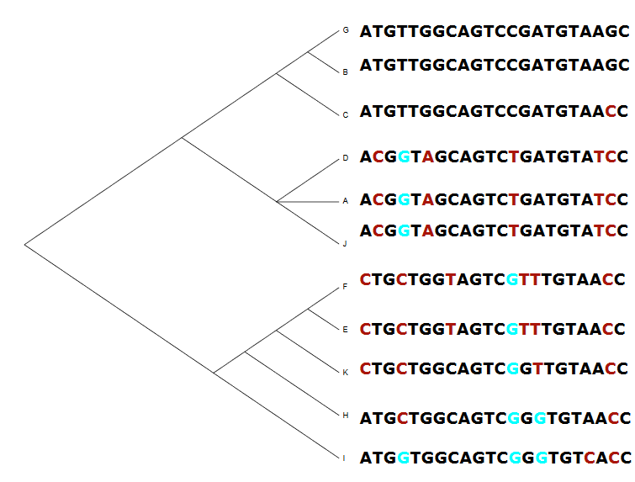
Computational approaches to biological problems
Phylogenetic analysis
Phylogenetic analysis attempts to describe the evolutionary relatedness of a group of sequences.
A traditional phylogenetic tree or cladogram groups species into a diagram that represents their relative evolutionary divergence.
Branchings of the tree that occur furthest from the root separate individual species; branchings that occur close to the root group species into kingdoms, phyla, classes, families, genera, and so on.
The information in a molecular sequence alignment can be used to compute a phylogenetic tree for a particular family of gene sequences.
The branchings in phylogenetic trees represent evolutionary distance based on sequence similarity scores or on information-theoretic modeling of the number of mutational steps required to change one sequence into the other.

Slide 17
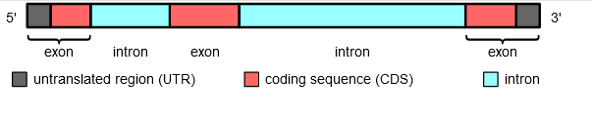
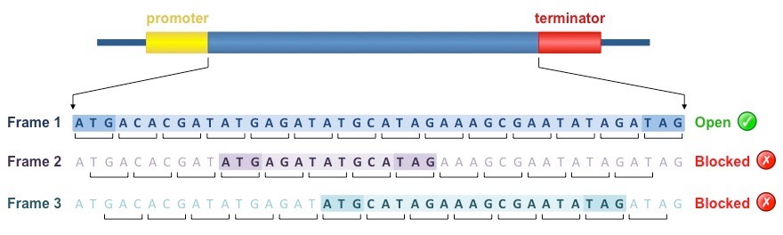
Computational approaches to biological problems
Gene prediction
Gene prediction is only one of a cluster of methods for attempting to detect meaningful signals in uncharacterized DNA sequences.
Until recently, most sequences deposited in GenBank were already characterized at the time of deposition.
That is, someone had already gone in and, using molecular biology, genetic, or biochemical methods, figured out what the gene did.
However, now that the genome projects are in full swing, there's a lot of DNA sequence out there that isn't characterized.
Software for prediction of open reading frames, genes, exon splice sites, promoter binding sites, repeat sequences, and tRNA genes helps molecular biologists make sense out of this unmapped DNA.

Slide 18
Computational approaches to biological problems
Extraction of patterns and profiles from sequence data
A motif is a sequence of amino acids that defines a substructure in a protein that can be connected to function or to structural stability.
In a group of evolutionarily related gene sequences, motifs appear as conserved sites. Sites in a gene sequence tend to be conserved to remain the same in all or most representatives of a sequence family when there is selection pressure against copies of the gene that have mutations at that site.
Nonessential parts of the gene sequence will diverge from each other in the course of evolution, so the conserved motif regions show up as a signal in a sea of mutational noise.
Sequence profiles are statistical descriptions of these motif signals; profiles can help identify distantly related proteins by picking out a motif signal even in a sequence that has diverged radically from other members of the same family.

Slide 19
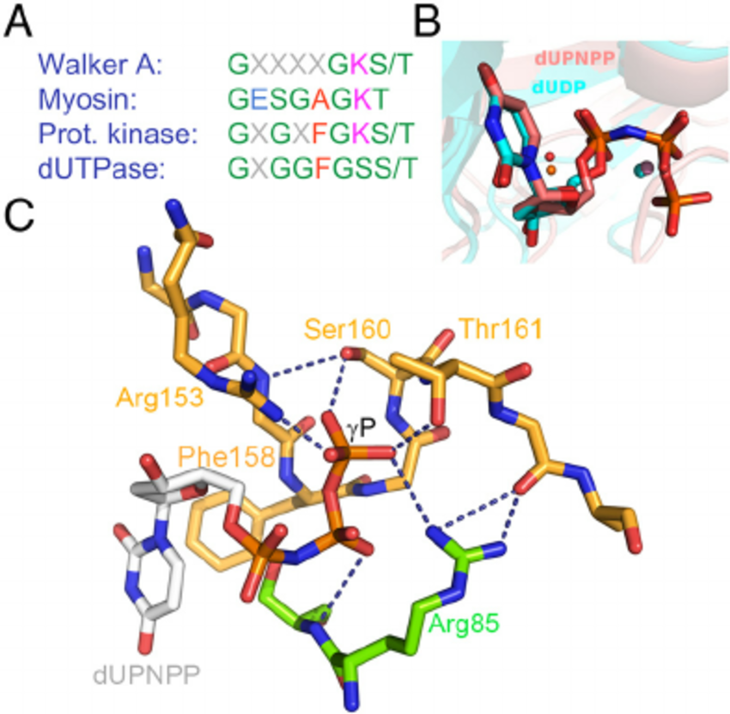
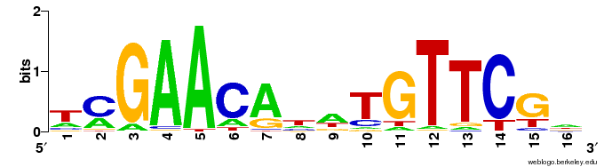
Computational approaches to biological problems
Extraction of patterns and profiles from sequence data
Consensus pattern: [AG]-x(4)-G-K-[ST]
ATP/GTP-binding site motif A (P-loop)
A DNA sequence motif represented as a sequence logo for the LexA-binding motif.
Pecsi et al. , 2011

Slide 20
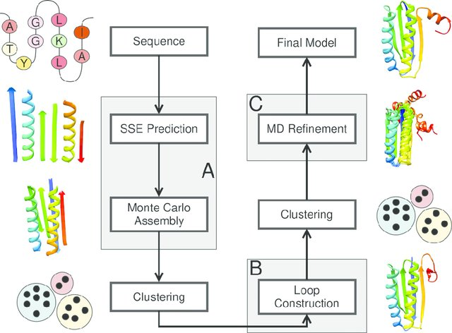
Computational approaches to biological problems
Protein structure prediction
It's a lot harder to determine the structure of a protein experimentally than it is to obtain DNA sequence data.
One very active area of bioinformatics and computational biology research is the development of methods for predicting protein structure from protein sequence.
Methods such as secondary structure prediction and threading can help determine how a protein might fold, classifying it with other proteins that have similar topology, but they don't provide a detailed structural model.
The most effective and practical method for protein structure prediction is homology modeling using a known structure as a template to model a structure with a similar sequence.

Slide 21
Computational approaches to biological problems
Protein structure property analysis
Protein structures have many measurable properties that are of interest to crystallographers and structural biologists.
Protein structure validation tools are used by crystallographers to measure how well a structure model conforms to structural rules extracted from existing structures or chemical model compounds.
These tools may also analyze the "fitness" of every amino acid in a structure model for its environment, flagging such oddities as buried charges with no countercharge or large patches of hydrophobic amino acids found on a protein surface.
These tools are useful for evaluating both experimental and theoretical structure models.
Another class of tools can calculate internal geometry and physicochemical properties of proteins. These tools usually are applied to help develop models of the protein's catalytic mechanism or other chemical features.
Some of the most interesting properties of protein structures are the locations of deeply concave surface clefts and internal cavities, both of which may point to the location of a cofactor binding site or active site.
Other tools compute hydrogen-bonding patterns or analyze intramolecular contacts.
A particularly interesting set of properties are the electrostatic potential field surrounding the protein and other electrostatically controlled parameters such as individual amino acid pKas, protein solvation energies, and binding constants.

Slide 22
Computational approaches to biological problems
Biochemical simulation
Biochemical simulation uses the tools of dynamical systems modeling to simulate the chemical reactions involved in metabolism.
Simulations can extend from individual metabolic pathways to transmembrane transport processes and even properties of whole cells or tissues.
Biochemical and cellular simulations traditionally have relied on the ability of the scientist to describe a system mathematically, developing a system of differential equations that represent the different reactions and fluxes occurring in the system.
However, new software tools can build the mathematical framework of a simulation automatically from a description provided interactively by the user, making mathematical modeling accessible to any biologist who knows enough about a system to describe it according to the conventions of dynamical systems modeling.

Slide 23
Computational approaches to biological problems
Whole genome analysis
As more and more genomes are sequenced completely; the analysis of raw genome data has become a more important task.
There are a number of perspectives from which one can look at genome data: for example, it can be treated as a long linear sequence, but it's often more useful to integrate DNA sequence information with existing genetic and physical map data.
This allows you to navigate a very large genome and find what you want.
The National Center for Biotechnology Information (NCBI) and other organizations are making a concerted effort to provide useful web interfaces to genome data, so that users can start from a high-level map and navigate to the location of a specific gene sequence.
Genome navigation is far from the only issue in genomic sequence analysis, however. Annotation frameworks, which integrate genome sequence with results of gene finding analysis and sequence homology information, are becoming more common, and the challenge of making and analyzing complete pairwise comparisons between genomes is beginning to be addressed.

Slide 24
Computational approaches to biological problems
Primer design
Many molecular biology protocols require the design of oligonucleotide primers.
Proper primer design is critical for the success of polymerase chain reaction (PCR), oligo hybridization, DNA sequencing, and microarray experiments.
Primers must hybridize with the target DNA to provide a clear answer to the question being asked, but they must also have appropriate physicochemical properties; they must not self-hybridize or dimerize; and they should not have multiple targets within the sequence under investigation.
There are several web-based services that allow users to submit a DNA sequence and automatically detect appropriate primers, or to compute the properties of a desired primer DNA sequence

Slide 25
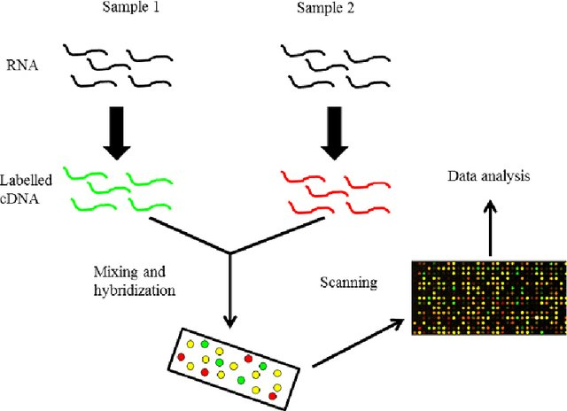
Computational approaches to biological problems
DNA microarray analysis
DNA microarray analysis is a molecular biology method that expands on classic probe hybridization methods to provide access to thousands of genes at once.
Microarray experiments are amenable to computational analysis because of the uniform, standardized nature of their results a grid of equally sized spots, each identifiable with a particular DNA sequence.
Computational tools are required to analyze larger microarrays because the resulting images are so visually complex that comparison by hand is no longer feasible.
The main tasks in microarray analysis as it's currently done are an image analysis step, in which individual spots on the array image are identified and signal intensity is quantitated, and a clustering step, in which spots with similar signal intensities are identified.
Computational support is also required for the chip design phase of a microarray experiment to identify appropriate oligonucleotide probe sequences for a particular set of genes and to maintain a record of the identity of each spot in a grid that may contain thousands of individual experiments.

Slide 26
Computational approaches to biological problems
Proteomics analysis
Before they're ever crystallized and biochemically characterized, proteins are often studied using a combination of gel electrophoresis, partial sequencing, and mass spectroscopy.
2D gel electrophoresis can separate a mixture of thousands of proteins into distinct components; the individual spots of material can be blotted or even cut from the gel and analyzed.
Simple computational tools can provide some information to aid in the process of analyzing protein mixtures.
It's trivial to compute molecular weight and pI from a protein sequence; by using these values in combination, sets of candidate identities can be found for each spot on a gel.
It's also possible to compute, from a protein sequence, the peptide fingerprint that is created when that protein is broken down into fragments by enzymes with specific protein cleavage sites.
Mass spectrometric analyses of protein fragments can be compared to computed peptide fingerprints to further limit the search.

Slide 27
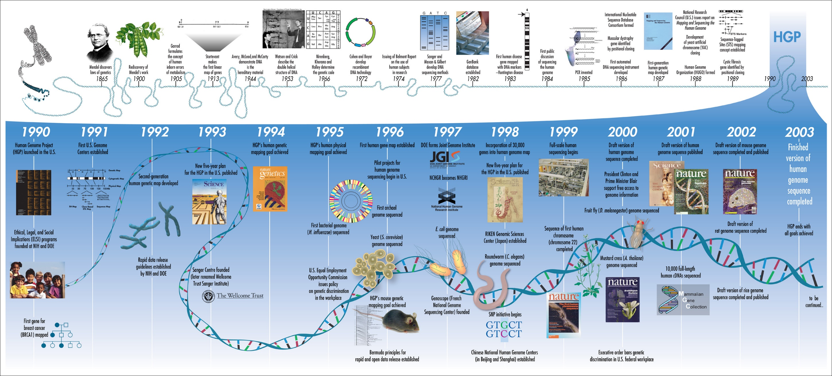
History of Bioinformatics

Slide 28
History of Bioinformatics
1950s :
not much was known about deoxyribonucleic acid (DNA)
Its status as the carrier molecule of genetic information was still controversial at that time.
Chargaff’s rule : Nucleotides have 1:1 proportion of purines and pyrimidines
Despite this breakthrough, it would take 13 more years before deciphering the genetic code and 25 more years before the first DNA sequencing methods became available
Consequently, the use of bioinformatics in DNA analysis lagged nearly two decades behind the analysis of proteins, whose chemical nature was already better understood than DNA.
1953 : the double-helix structure of DNA was finally solved by Watson, Crick and Franklin

Slide 29
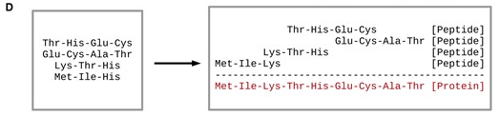
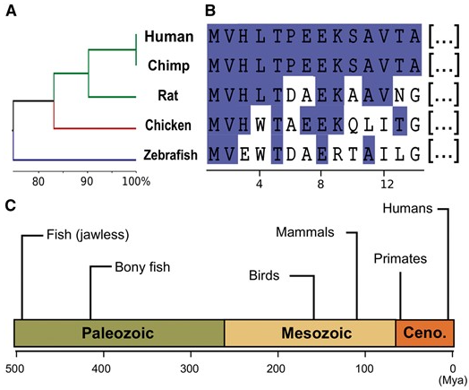
History of Bioinformatics
1960s :
Margaret Dayhoff :
an American physical chemist who pioneered the application of computational methods to the field of biochemistry
the mother and father of bioinformatics
1962 – developed COMPROTEIN - to determine protein primary structure using Edman peptide sequencing data
Zuckerkandl and Pauling in 1963 coined the term ‘Paleogenetics’ to introduce this novel branch of evolutionary biology
For instance, they observed that human hemoglobin showed higher conservation with chimpanzee (Pan troglodytes) hemoglobin than with mouse (Mus musculus) hemoglobin.

Slide 30
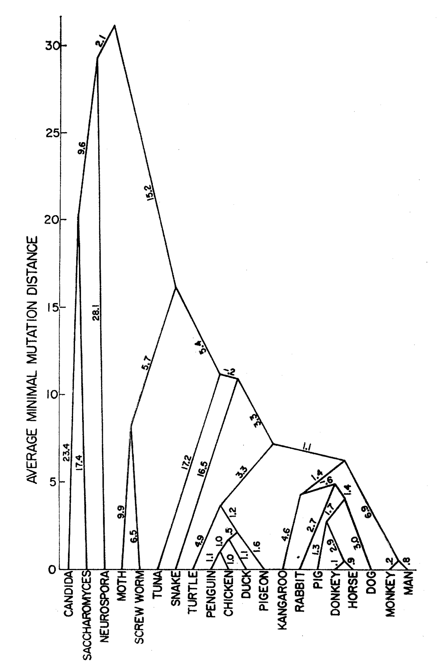
History of Bioinformatics
1960s :
Margoliash and Fitch used variation in the cytochrome c substitution rate to constructed phylogenetic trees.
Phylogeny as reconstructed from observable mutations in the cytochrome c gene.

Slide 31
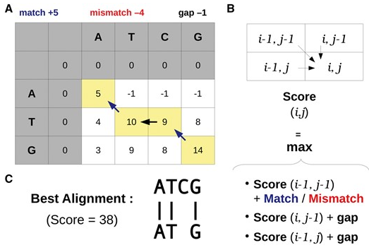
History of Bioinformatics
1970s : (Reproducible algorithm for alignment)
Needleman and Wunsch, 1970, developed the first dynamic programming algorithm for pairwise protein sequence alignments – Global alignment
Temple F. Smith and Michael S. Waterman in 1981 modified the Needleman–Wunsch algorithm for local sequence alignment
The first truly practical approach to MSA was developed by Da-Fei Feng and Russell F. Doolitle in 1987 – CLUSTAL program implemented this algorithm
Protein Sequence Database (PSD) by Margaret Dayhoff.
PIR-International Protein Sequence Database (PIR-PSD), the world's first database of classified and functionally annotated protein sequences that grew out of the Atlas of Protein Sequence and Structure (1965-1978) edited by Margaret Dayhoff.

Slide 32
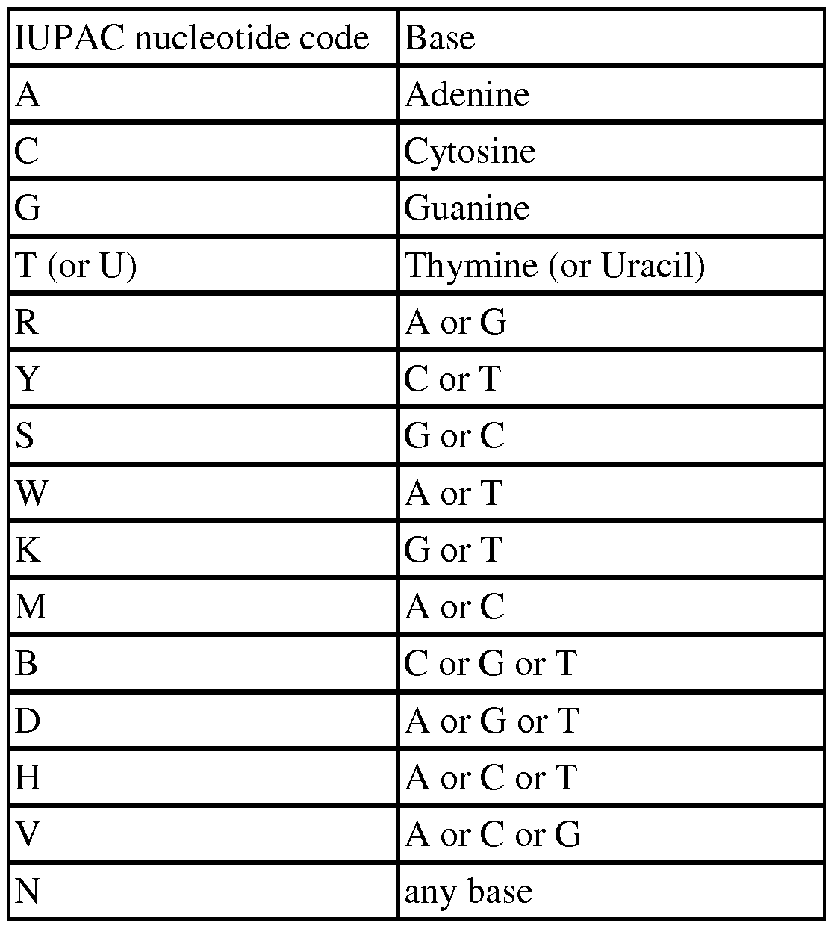
History of Bioinformatics
1970s – 80s : (protein to DNA analysis )
The Staden Package was one of the first sequence analysis software to include additional characters (which Staden called ‘uncertainty codes’) to record basecalling uncertainties in a sequence read.
This extended DNA alphabet was one of the precursors of the modern IUPAC nomenclature for incompletely specified bases in nucleic acid sequences
the first molecular phylogenetic trees were reconstructed from protein sequences, and typically assumed maximum parsimony (i.e. the least number of changes) as the main mechanism driving evolutionary change.

Slide 33
History of Bioinformatics
1980 – 90s :
Jackson, Symons and Berg (1972) used restriction endonucleases and DNA ligase to cut and insert the circular SV40 viral DNA into lambda DNA, and then transform Escherichia coli cells with this construct.
As the inserted DNA molecule is replicated in the host organism, it is also amplified as E. coli cultures grow, yielding several million copies of a single DNA insert.
The second milestone in manipulating DNA was the polymerase chain reaction (PCR), invented by Kary Mullis, which allows to amplify DNA without cloning procedures.
The emergence of DNA sequencing in the late 1970s, along with enhanced DNA manipulation techniques, has resulted in more and more available sequence data.
In parallel, the 1980s saw increasing access to both computers and bioinformatics software
During this period that the European Molecular Biology Laboratory (EMBL) (1980), GenBank (1982) and DNA Data Bank of Japan (DDBJ) (1986) sequence databases united in order, to standardize data formatting, to define minimal information for reporting nucleotide sequences and to facilitate data sharing

Slide 34
History of Bioinformatics
1980 – 90s :
Perl (Practical Extraction and Reporting Language) is a high-level, multiparadigm, interpreted scripting language that was created in 1987 by Larry Wall to facilitate parsing and reporting of text data.
This Perl programming interface provides modules that facilitate typical but nontrivial tasks, such as
accessing sequence data from local and remote databases,
switching between different file formats,
similarity searches, and
annotating sequence data.
Python, just like Perl, is a high-level, multiparadigm programming language that was first implemented by Guido van Rossum in 1989.
Python was especially designed to have a simpler vocabulary and syntax to make code reading and maintenance simpler (at the expense of flexibility), even though both languages can be used for similar applications.
In addition to Perl and Python, several nonscripting programming languages originated in the early 1990s and joined the bioinformatics scene later on

Slide 35
History of Bioinformatics
1990s – 2000s : Genomics
In 1995, the first complete genome sequencing of a free-living organism (Haemophilus influenzae) was sequenced by The Institute for Genomic Research (TIGR) led by geneticist J. Craig Venter
However, the turning point that started the genomic era, as we know it actually, was the publication of the human genome at the beginning of the 21st century
The Human Genome Project was initiated in 1991 by the U.S. National Institutes of Health, and cost $3 billion in taxpayer money over 13 years.
In 1998, Celera Genomics led a rival, private effort to sequence and assemble the human genome which successfully sequenced and assembled the human genome for one-tenth of the National Institutes of Health (NIH)-funded project cost.
This 10-fold difference between public and private effort costs resulted from different experimental strategies as well as the use of NIH data by the Celera-led project

Slide 36
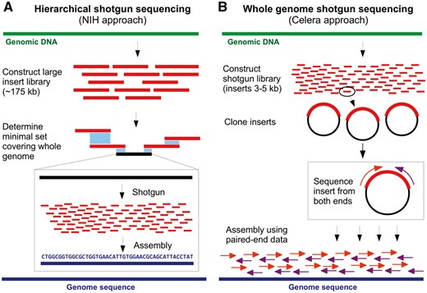
History of Bioinformatics
1990s – 2000s : Genomics

Slide 37
History of Bioinformatics
1990s – 2000s : Genomics
Although the scientific community was experiencing a time of great excitement, whole-genome sequencing required millions of dollars and years to reach completion, even for a bacterial genome.
In contrast, sequencing a human genome with 2018 technology would cost $1000 and take less than a week.
This massive cost discrepancy is not so surprising; at this time, even if various library preparation protocols existed, sequencing reads were generated by using Sanger capillary sequencers.
Those had a maximum throughput of 96 reads of 800 bp length per run, orders of magnitude less than second-generation sequencers that emerged in the late 2000s.
Thus, sequencing the human genome (3.0 Gbp) required a rough minimum of about 40 000 runs to get just one-fold coverage.
In addition to laborious laboratory procedures, specialized software had to be designed to tackle this unprecedented amount of data.
Several pioneer Perl-based software were developed in the mid to late 1990s to assemble whole-genome sequencing read

Slide 38
History of Bioinformatics
1990s – 2000s : Internet
The world’s first nucleotide sequence database, the EMBL Nucleotide Sequence Data Library (that included several other databases such as SWISS-PROT and REBASE), was made available on the Web in 1993
It was almost at the same time, in 1992, that the GenBank database became the responsibility of the NCBI
However, GenBank was very different from today and was distributed in print and as a CD-ROM in its first inception.
NCBI webtools such as BLAST was made available online in 1994
Then came the establishment of several major databases still used today: Genomes (1995), PubMed (1997) and Human Genome (1999).
The rise of Web resources also broadened and simplified access to bioinformatics tools, mainly through Web servers with a user-friendly graphical user interface.

Slide 39
History of Bioinformatics
2000s – 2010s : High-throughput bioinformatics
Next-generation (Second-Generation) sequencing
DNA sequencing was democratized with the advent of second-generation sequencing (also called next-generation sequencing or NGS) that started with the ‘454’ pyrosequencing technology
This technology allowed sequencing thousands to millions of DNA molecules in a single machine run, thus raising again the old computational challenge.
Now, several other companies and technologies are on the market and a multitude of tools is available to deal with the sequences.
In fact, there are now so many tools that it is difficult to choose a specific one.
If this trend persists, it will become increasingly difficult for different teams to compare their findings and to replicate results from other research groups.
Furthermore, switching to newer and/or different bioinformatics tools requires additional training and testing, thereby making researchers reluctant to abandon software they are familiar with.
However, the increasing amount of available tools is dwarfed by the exponential increase of biological data deposited in public databases.

Slide 40
History of Bioinformatics
2000s – 2010s : High-throughput bioinformatics
Biological Big Data
Since 2008, DNA sequencing costs dropped several orders of magnitude after the arrival of massively parallel sequencing technologies
This resulted in an exponential increase of sequences in public databases such as GenBank and WGS and further preoccupations towards Big Data issues.
In fact, the scientific community has now generated data beyond the exabyte (10¹⁸) level.
Major computational resources are necessary to handle all of this information, obviously to store it, but also to organize it for easy access and use.
New repository infrastructure arose for model organisms such as Drosophila, Saccharomyces and human.
Those specialized databases are of great importance, as in addition to providing genomic sequences with annotations (often curated) and metadata, many of them are structuring resources for the scientific community working on these organisms.

Slide 41
History of Bioinformatics
Structural Bioinformatics
The first three-dimensional structure of a protein, that of myoglobin, was determined experimentally in 1958 using X-ray diffraction
However, the first milestones concerning the prediction of a protein structure were laid by Pauling and Corey in 1951 with the publication of two articles that reported the prediction of α-helices and β-sheets
As with other areas in the biological sciences, it is now possible to use computers to perform calculations to predict, with varying degrees of certainty, the secondary and tertiary structure of proteins
Although advances in the field of 3D structure prediction are crucial, it is important to remember that proteins are not static, but rather a dynamic network of atoms.
With some breakthroughs in biophysics, force fields have been developed to describe the interactions between atoms, allowing the release of tools to model the molecular dynamics of proteins in the 1990s

Slide 42
History of Bioinformatics
Structural Bioinformatics
Although theoretical methods had been developed and tools were available, it remained very difficult in practice to perform molecular dynamics simulations due to the large computational resources required.
For example, in 1998, a microsecond simulation of a 36-amino-acid peptide (villin headpiece subdomain) required months of calculations despite the use of supercomputers with 256 central processing units
Despite the constant increase in the power of modern computers, for many biomolecules, computing resources still remain a problem for making molecular dynamics simulations on a reasonable time scale.
Nevertheless, there have been, and continue to be, several innovations, such as the use of graphics processing units (GPUs) through high-performance graphics cards normally used for graphics or video games, that help to make molecular dynamics accessible.
Moreover, the use of GPUs also began to spread in other fields of bioinformatics requiring massive computational power, such as the construction of molecular phylogenies

Slide 43
History of Bioinformatics
1. The Discovery of DNA's Double Helix Structure (1953)
James Watson and Francis Crick, with contributions from Rosalind Franklin and Maurice Wilkins, discovered the double helix structure of DNA.
This discovery was fundamental in understanding genetic information storage and transmission, paving the way for molecular biology and bioinformatics.
2. Development of the First Protein Sequence (1955)
Frederick Sanger sequenced insulin, marking the first protein sequence ever determined.
This achievement demonstrated the feasibility of sequencing biological molecules, leading to the development of methods for sequencing DNA and proteins.
3. The Birth of Computational Biology (1960s-1970s)
The advent of computers allowed for the analysis of biological data. Early computational tools were developed for sequence alignment and phylogenetic analysis.
These tools laid the groundwork for modern bioinformatics, enabling researchers to compare sequences and understand evolutionary relationships.
4. Introduction of Algorithms for Sequence Alignment (1970)
Needleman and Wunsch developed the first algorithm for sequence alignment.
This algorithm, and later the Smith-Waterman algorithm, became essential for comparing sequences, identifying homologous regions, and inferring functional and evolutionary relationships.
5. Creation of GenBank (1982)
The National Institutes of Health (NIH) established GenBank, a public database for nucleotide sequences.
GenBank became a central repository for genetic information, fostering data sharing and collaboration among researchers worldwide.

Slide 44
History of Bioinformatics
6. The Human Genome Project (1990-2003)
An international effort to sequence the entire human genome.
This project generated vast amounts of genetic data, driving advances in sequencing technology, data analysis, and bioinformatics tools. It also highlighted the need for computational approaches to manage and analyze large datasets.
7. Development of BLAST (1990)
Altschul et al. developed the Basic Local Alignment Search Tool (BLAST).
BLAST became one of the most widely used tools for sequence comparison, allowing researchers to quickly find regions of similarity between sequences and identify genes and proteins.
8. Introduction of High-Throughput Sequencing Technologies (2000s)
The development of next-generation sequencing (NGS) technologies.
NGS revolutionized genomics by significantly reducing the cost and time required for sequencing. This led to an explosion of genomic data and necessitated advanced bioinformatics methods for data processing and analysis.
9. Advances in Structural Bioinformatics (2000s)
The development of computational methods for predicting protein structure, such as homology modeling and molecular dynamics simulations.
These methods allowed for the prediction of protein structures from sequences, facilitating the understanding of protein function and interactions, and aiding in drug discovery.
10. Emergence of Systems Biology (2000s-Present)
The integration of bioinformatics with systems biology to model and understand complex biological systems.
Systems biology approaches have enabled the study of interactions within biological networks, providing insights into cellular processes, disease mechanisms, and potential therapeutic targets.

Slide 45
Margaret Oakley Dayhoff (1925-1983) : Father/Mother of Informatics Pioneering Work in Protein and Nucleotide Sequence Analysis Development of the PAM Matrices (1978): Dayhoff created the first substitution matrices, known as Point Accepted Mutation (PAM) matrices, which are essential for sequence alignment and evolutionary studies. These matrices provide a quantitative method to score the alignment of protein sequences and are still widely used today. The Atlas of Protein Sequence and Structure (1965) First Compilation of Protein Sequences: Dayhoff published the first comprehensive collection of protein sequences, which was a significant resource for researchers. This compilation laid the groundwork for databases like GenBank and Swiss-Prot. This work demonstrated the importance of storing and systematically organizing biological data, which is a core principle of bioinformatics. Early Use of Computers in Biology Automating Sequence Analysis: Dayhoff was one of the first to use computers for comparing and analyzing protein sequences. Her efforts in this area showcased the potential of computational methods in biological research. Development of Bioinformatics Tools: She developed several computational tools and algorithms for sequence alignment, database searching, and evolutionary analysis.

Slide 46
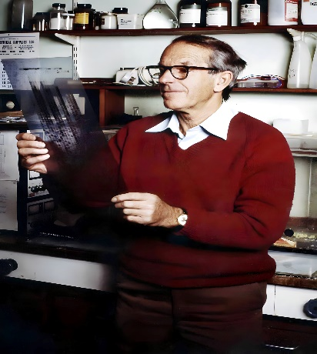
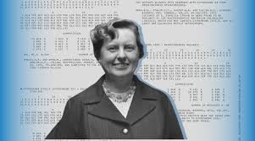
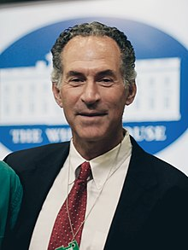
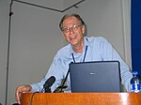
Establishment of Bioinformatics as a Discipline Leadership and Advocacy: Dayhoff was instrumental in establishing bioinformatics as a distinct scientific discipline. She advocated for the systematic collection, storage, and analysis of biological data using computational methods. Community Building: Her work helped to build a community of researchers focused on bioinformatics, fostering collaboration and innovation in the field. Other Key Figures While Dayhoff is often credited with foundational contributions to bioinformatics, other scientists have also played significant roles in shaping the field: Frederick Sanger: His development of sequencing methods for proteins and nucleic acids was crucial for generating the data that bioinformatics tools analyze. David J. Lipman: Known for his work on the development of the BLAST algorithm, which revolutionized sequence comparison and database searching. Michael Waterman: Co-developer of the Smith-Waterman algorithm for local sequence alignment.

Slide 47
Introduction to Database
Database is a computerized resource where data is structured in a way that makes it easy to add, access, and update it.
The main purpose of databases is to enable easy handling and retrieval of information through multiple search features.
Database is organized in a way that each data entry represents a record. A record contains multiple items of data; therefore it consists of a number of fields. For example, names, phone numbers, addresses, etc. are all attached to one particular record.
To search the database for a specific record, the user can use information given in a single field to retrieve the whole record.
In data science, this is called as making a query.

Slide 48
Introduction to Database
Database is a collection of related data elements such as Tables, Columns, and Rows.
Tables (entities)
Basic elements of information to track, e.g., gene, organism, sequence, citation
Columns (fields or attributes)
Fields describe what data is stored attributes of tables, e.g. for citation table, title, journal, volume, author
Rows (records)
Rows of a table are where the actual data is stored
Before analyzing them we need to assemble them into central, shareable resources so that contents can be easily accessed, managed and updated

Slide 49
Introduction to Database
Need for Databases
Exponential growth of sequences, structures and literature
Need for efficient storage and management tools
Need for standardization
Means to handle and share large volumes of biological data
Support large-scale analysis efforts
Make data access easy and updated
Link knowledge obtained from various fields of biology and medicine

Slide 50
Introduction to Database
Biological databases are libraries of life sciences information collected from scientific experiments, published literature, high-throughput experiment technology, and computational analysis.
They contain information from research areas including genomics, proteomics, metabolomics, microarray gene expression, and phylogenetics.
Information contained in biological databases includes gene function, structure, localization (both cellular and chromosomal), clinical effects of mutations as well as similarities of biological sequences and structures.

Slide 51
Introduction to Database
Biological databases have tools for higher level information processing. Their objective is not only to store information but also to discover. They often have the ability to detect connections among new entries and previously archived data to avoid overlapping of the data.
They also can perform computational operations on the stored data, for example, detect sequence homology or certain motifs. This facilitates a comprehensive holistic approach to biological data.

Slide 52
Introduction to Database
Types of databases:
When databases originated, they were in the form of plain text file with multiple entries separated by vertical or horizontal delimiter, e.g., a vertical bar or any other suitable character, much like a large table where raw data is stored.
It didn’t support further tasks like finding similarities or repetitions or adopting keywords. For a computer to search for a certain piece of information, it had to read through all the regions of the text.
This is a time-consuming process that requires a heavy-duty processor and intense-performance memory.
For small databases, it shouldn’t be a problem, but biological ones are often very large with a huge amount of data in different fields.

Slide 53
Introduction to Database
Types of databases:
Computers are often crashed during the search processes if they exceed the capacity of their operating systems. Thus, to facilitate accessing and searching through the data, many sophisticated software programs have been designed and installed.
They are programmed to find connections among the raw information entered into the database.
These software programs are called database management systems with the function of storing, monitoring, and sorting all types of information.
They structure the raw data into sets according to different combinations and connections they can find, making the search processes more organized and effective. Hence, they can make reports of the search and conclude more information from the raw data entries.

Slide 54
Introduction to Database
Types of Biological databases
Biological databases were broadly classified into three major categories as sequence, structure, and functional databases.
The sequences of proteins and the nucleic acids are stored in sequence databases, and their solved structure of transcripts, as well as proteins, are stored in structural databases.
Based on their contents, biological databases can be divided into three classes, i.e., primary, secondary, and specialized databases.

Slide 55
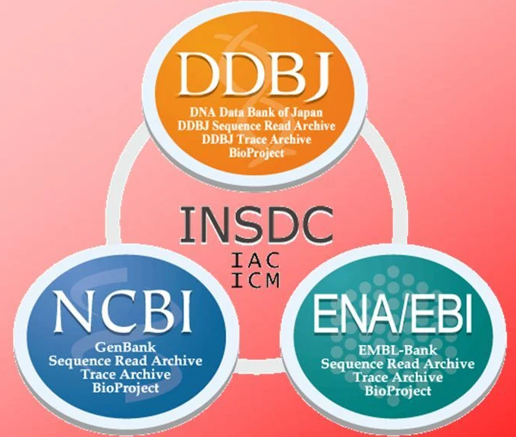
Introduction to Database
Primary Databases:
Primary databases serve as computational archives containing only raw data, e.g., nucleic acids and protein sequences.
They are populated with experimentally derived data such as nucleotide sequence, protein sequence or macromolecular structure.
Experimental results are submitted directly into the database by researchers, and the data are essentially archival in nature.

Slide 56
Introduction to Database
Primary Databases:
Once given a database accession number, the data in primary databases are never changed: they form part of the scientific record.
Primary database are open access i.e. they are freely available on the Internet.
These databases contain data which has been freely deposited by the researchers from around the world but this data lacks proper annotation.
Most international journals nowadays require the authors to annotate and submit their protein and/or DNA sequence to any of the three databases before accepting their article for publication. Publishers in this way can validate all sequences or structures submitted against those already available in the database for redundancy or other purposes.

Slide 57
Introduction to Database
Secondary Databases
Primary databases often lack annotation and multiple other features. Thus, information processing tools are of much importance as they turn the plain raw data into more sophisticated knowledge.
Secondary databases have this capability alongside their ability to analyze information and draw conclusions.
Secondary databases vary in how advanced they process the data extracted from the primary ones.
Secondary biological databases use the original data in primary databases to derive new data sets by using specialized software programs or by manual annotation of information.

Slide 58
Introduction to Database
Secondary Databases
Some secondary databases have only a limited degree of processing and translate the sequence data from stored DNA. Others have higher levels of analyzing and handling information.
Data are extracted from published literature and added to the database for curation and annotation.
This is done manually ensuring a high level of accuracy and up-to-date information.
They provide info about annotation, family rank, function, and structure. Any protein in the database is annotated with its function, structure, catalytic sites, domain, metabolic pathway, disease association, and any other relative information

Slide 59
Introduction to Database
Derived databases:
Derived databases contain special feature-based information that includes model organisms’ databases, pathways, as well as disease-related information of human being.
Derived databases are large-scale collaborations between members of the scientific community devoted to a specific disease or a certain organism.
The abundance of data and lack of organization were the main reasons for their appearance.
Information in these specialized databases is usually curated by authors or experts in the field, which indicates that they may have advanced computational capabilities than secondary databases.

Slide 60
Introduction to Database
Derived databases:
This databases may also allow interactive platforms where the users can add notes or comments.
An example of this is the Parkinson disease map project by department of life sciences and biological systems at Luxembourg University. Taxonomic-specific databases are also specialized ones.
https://wwwfr.uni.lu/lcsb/research/parkinson_s_disease_map

Slide 61
Introduction to Database
Types of Biological databases
Primary database
Nucleotide sequence database : GeneBank, DDBJ, EMBL
Protein sequence database : UniProt, SwissProt, PIR
Protein structure database : PDB
Secondary database
Protein structure database : PDB, MMDB
Domain and motif database : Prosite, PRINTS
Derived database
Structure database : SCOP, CATH
Gene expression database : GEO, GXD
Metabolic pathway database : KEGG
Specialized database : GPCRD

Slide 62
Introduction to Database
Primary Databases (Nucleotide):
Gen Bank
https://www.ncbi.nlm.nih.gov/genbank/
European Molecular Biology Laboratory (EMBL)
https://www.embl.org/
DNA Data Bank of Japan (DDBJ)
https://www.ddbj.nig.ac.jp/index-e.html
These three databases collaborate with each other exchanging new data nearly every day. So, a researcher only needs to access one of them to avail the latest information.
The three databases together make the International Nucleotide Sequence Database Collaboration(INSDC).
Despite having the same data, they have different designs and display formats.

Slide 63
Introduction to Database
Protein Information Resource (PIR) – Protein Sequence Database (PIR-PSD)
The PIR-PSD is a collaborative endeavor between the PIR, the MIPS (Munich Information Centre for Protein Sequences, Germany) and the JIPID (Japan International Protein Information Database, Japan).
The PIR-PSD is now a comprehensive, non-redundant, expertly annotated, object-relational DBMS.
A unique characteristic of the PIR-PSD is its classification of protein sequences based on the superfamily concept.
The sequence in PIR-PSD is also classified based on homology domain and sequence motifs.
Homology domains may correspond to evolutionary building blocks, while sequence motifs represent functional sites or conserved regions.
The classification approach allows a more complete understanding of sequence function-structure relationship.

Slide 64
Introduction to Database
Primary Databases (Proteins):
SWISS-PROT
The other well known and extensively used protein database is SWISS-PROT. Like the PIR-PSD, this curated proteins sequence database also provides a high level of annotation.
The data in each entry can be considered separately as core data and annotation.
The core data consists of the sequences entered in common single letter amino acid code, and the related references and bibliography. The taxonomy of the organism from which the sequence was obtained also forms part of this core information.

Slide 65
Introduction to Database
Primary Databases (Proteins):
SWISS-PROT
The annotation contains information on the function or functions of the protein, post-translational modification such as phosphorylation, acetylation, etc., functional and structural domains and sites, such as calcium binding regions, ATP-binding sites, zinc fingers, etc., known secondary structural features as for examples alpha helix, beta sheet, etc., the quaternary structure of the protein, similarities to other protein if any, and diseases that may arise due to different authors publishing different sequences for the same protein, or due to mutations in different strains of an described as part of the annotation.

Slide 66
Introduction to Database
Primary Databases (Proteins):
UniProt:
It stands for Universal Protein resources.
It is a central repository or protein sequences and function, created by joining the information contained in UniProt/SwissProt.
PDB:
PDB stands for protein Data Bank.
The RCSB PDB provides a variety of tools and resources for studying the structures of biological macromolecules and their relationships to sequence, function, and disease.

Slide 67
Introduction to Database
Primary Databases (Proteins):
Protein Databank (PDB)
PDB is a primary protein structure database. It is a crystallographic database for the three-dimensional structure of large biological molecules, such as proteins.
In spite of the name, PDB archive the three-dimensional structures of not only proteins but also all biologically important molecules, such as nucleic acid fragments, RNA molecules, large peptides and complexes of protein and nucleic acids.
The database holds data derived from mainly three sources: Structure determined by X-ray crystallography, NMR experiments, and molecular modeling.

Slide 68
Introduction to Database
Protein Databank (PDB)
The wwPDB is composed of four partners:
Research Collaboratory for Structural Bioinformatics Protein Data Bank (RCSB PDB)
https://www.rcsb.org/
Protein Data Bank in Europe (PDBe)
https://www.ebi.ac.uk/pdbe/
Protein Data Bank Japan (PDBj)
https://pdbj.org/
Biological Magnetic Resonance Data Bank (BMRB)
https://bmrb.io/

Slide 69
Introduction to Database
Secondary Databases:
TrEMBL (Translated EMBL)
TrEMBL is a computer-annotated protein sequence database that is released as a supplement to SWISS-PROT.
It contains the translation of all coding sequences present in the EMBL Nucleotide database, which have not been fully annotated.
Thus it may contain the sequence of proteins that are never expressed and never actually identified in the organisms.

Slide 70
Introduction to Database
Secondary Databases:
PROSITE
PROSITE is a protein database.
It consists of entries describing the protein families, domains and functional sites as well as amino acid patterns and profiles in them.
These are manually curated by a team of the Swiss Institute of Bioinformatics and tightly integrated into Swiss-Prot protein annotation.
Classification of proteins in Prosite is determined using single conserved motifs, i.e., short sequence regions (10–20 amino acids) that are conserved in related proteins and usually have a key role in the protein’s function.
The search for such sequence motifs in unknown proteins can provide a first hint of an affiliation to a protein family or function.

Slide 71
Introduction to Database
Secondary Databases:
PRINTS
The PRINTS database uses fingerprints to classify sequences.
Fingerprints consist of several sequence motifs, represented in the PRINTS database by short, local, ungapped alignments.
The PRINTS database takes advantage of the fact that proteins usually contain functional regions that result in several sequence motifs per protein.
Like Prosite, PRINTS contains information about each protein family and, if available, the biological function of each motif in the fingerprint.

Slide 72
Introduction to Database
Secondary Databases:
Blocks
The limitations of the above two databases led to the formation of Block database.
In this database, the motifs (here called Blocks) are created automatically by highlighting and detecting the most conserved regions of each family of proteins.
Block databases are fully automated.
Keyword and sequence searching are the two important features of this type of database.
Blocks are ungapped Multiple Sequence Alignment representing conserved protein regions.

Slide 73
Introduction to Database
Secondary Databases:
Pfam
The Pfam database classifies protein families according to profiles.
A profile is a pattern that evaluates the probability of the appearance of a given amino acid, an insertion, or a deletion at every position in a protein sequence.
Conserved positions are weighted more than less conserved positions, i.e., a weighted scoring scheme.

Slide 74
Introduction to Database
Secondary Databases:
Pfam
Pfam is based on sequence alignments.
High-quality, manually checked alignments serve as starting points for the automatic construction of hidden Markov models (HMMs).
More sequences are then automatically added to the individual alignments of the SwissProt database.
The resulting alignments should represent functionally interesting structures and contain evolutionarily related sequences.
Owing to the partly automatic construction of the alignments, however, it is also possible that sequence alignments will arise that have no evolutionary relationship to one other. Therefore, the results of a search against the Pfam database should be carefully reviewed.

Slide 75
Introduction to Database
Derived databases:
FlyBase
https://flybase.org/
TAIR
https://www.arabidopsis.org/
Wormbase
https://wormbase.org

Slide 76
Introduction to Database
Derived databases – Structural Databases:
Structural databases are storage platforms that are devoted to the three-dimensional (3D) structural information of macromolecules.
The 3D structure determination of biomacromolecules is essential for understanding phenomena such as the mechanisms of disease development that can aid in the design of new drugs.
Also, 3D structures of biomacromolecules help to find the structure-function relationship.

Slide 77
Introduction to Database
Derived databases:
PDBsum: Structural Summaries of PDB Entries
https://www.ebi.ac.uk/thornton-srv/databases/cgi-bin/pdbsum/GetPage.pl?pdbcode=index.html
sc-PDB: A 3D Database of Ligandable Binding Sites
http://bioinfo-pharma.u-strasbg.fr/scPDB/
PDBTM: Protein Data Bank of Transmembrane Proteins
http://pdbtm.enzim.hu/
CATH Database
https://www.cathdb.info/
Structural Classification of Protein (SCOP)
http://scop.mrc-lmb.cam.ac.uk/scop/

Slide 78
Introduction to Database
Derived databases - Other Biological Databases:
Other biological database includes data types like two-dimensional gel electrophoresis images of protein expression, mutations, and polymorphism in molecular sequences and structures, metabolic pathways and molecular interactions, functional enrichment, genetic maps, and physiochemical data.

Slide 79
Introduction to Database
Derived databases:
SWISS 2D PAGE
The SWISS-2DPAGE database was developed in 1993 and maintained at the clinical laboratory of Geneva University Hospital.
The database holds proteins identified on various two-dimensional polyacrylamide gel electrophoresis using microsequencing, immunoblotting, gel comparison, and amino acid composition methods
Each entry in the database has textual information on a protein that include mapping procedures, physiological and pathological information, bibliographical references, and experimental data like isoelectric point, molecular weight, amino acid composition, and peptide masses.
Apart from the textual information, the database also provides images of various 2D PAGE and SDS-PAGE which depicts experimental protein localization and theoretical region calculated from the protein sequence

Slide 80
Introduction to Database
Derived databases:
UCSC Genome Browser: Annotation Database
UCSC genome browser is an online as well as stand-alone web-based tool maintained by the University of California.
This browser is designed to maintain the user-specified information accessible at any scale to conduct sequence annotations.
It has a graphical viewing tool that helps to screen the specified region of the genome.
The UCSC genome browser provides the information as in diverse array known as “Tracks,” including the gene prediction, mapping, as well as aligned genomic information.
This browser site anchors the collection of genomic analysis tools that include the full aspects of GUI web interface to extract the information from this database.
It has several online tools such as FAST sequence alignment and BLaTM tool that help to find the sequences from massive genomic sequences.

Slide 81
Introduction to Database
Derived databases:
PubMed
The PubMed literature database is an open-source database which searches for biomedical and life sciences literature.
It provides the access point to search the PMC, NCBI Bookshelf, as well as full text of collected books.
It is maintained by The United States National Library of Medicine (NLM) at the National Institutes of Health (NIH)
It can be accessed from Entrez system
It includes links to full text articles and other related resources, and includes over 18 millions citations for biomedical articles back to 1984.

Slide 82
Introduction to Database
Derived databases:
KEGG (Kyoto Encyclopedia of Genes and Genomes)
KEGG (Kyoto Encyclopedia of Genes and Genomes) is a series of databases developed by both the Bioinformatics Center of Kyoto University and the Human Genome Center of the University of Tokyo.
KEGG contains manually curated pathway maps which signify knowledge on molecular reaction, interaction, and relation networks for metabolism, organismal systems, human diseases, genetic information processing, environmental information processing, cellular process, and drug development.
KEGG collects crucial data relevant to biological systems including phenotype and genotype data and provides necessary information required for system biology understanding of genes, genome sequence, and chemical data.
This information is presented as a browser-viewable pathway diagram.
For instance, user can search and explore whether metabolic pathways or enzymes exist between molecules X and Y.

Slide 83
Introduction to Database
Derived databases:
OMIM
OMIM stands for “Online Mendelian Inheritance in Man”
It is a system of cataloging human genes and genetic diseases
It was first created by Dr. Victor McKusick of Johns Hopkins University
OMIM provides information about
The location on the chromosome
The alternative names for the disease
A complete description that includes the clinical features, the mapping, the inheritance, the epidemiology, the pathogenesis, and often many other important facts regarding the topic of interest

Slide 84
Format vs. Content
Database records are used to hold raw sequence data as well as an array of ancillary annotations.
In a survey of the various database formats, we can observe that, although different sets of rules are applied, it is still possible in many cases to interchange data among formats.
The best format for a human to read may not be the most efficient for a computer program.
Format – Relational Database, Object Oriented Database
Content – Usually Flat Files

Slide 85
Flat File
A flat file is a collection of data stored in a two-dimensional database in which similar yet discrete strings of information are stored as records in a table.
The columns of the table represent one dimension of the database, while each row is a separate record.
The information stored in a flat file is generally alphanumeric with little or no additional formatting.
The structure of a flat file is based on a uniform format as defined by the type and character lengths described by the columns.

Slide 86
Flat File
One of the most prominent flat file examples is a comma-separated values (CSV) file.
A CSV file is one in which table data is gathered in lines of American Standard Code for Information Interchange (ASCII) text with the value from each table cell separated by a comma and each row represented by a new line.
Columns and rows are typically delimited by tabs or commas, such as in CSV files. A flat file database comprises a single table.
The simplicity of the flat file, which does lend itself to simple tools that are available to all, is in great part responsible for the popularity of the EMBL and GenBank flatfile formats.
In its simplest form, a DNA sequence record can be represented as a string of nucleotides with some tag or identifier.

Slide 87
FASTA format
FASTA format is a text-based format for representing either nucleotide sequences or peptide sequences, in which base pairs or amino acids are represented using single-letter codes.
A sequence in FASTA format begins with a single-line description, followed by lines of sequence data.
The description line is distinguished from the sequence data by a greater-than (">") symbol in the first column.
It is recommended that all lines of text be shorter than 80 characters in length.

Slide 88
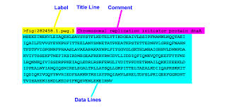
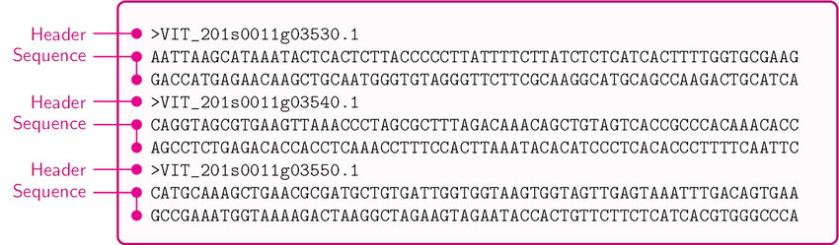
FASTA format

Slide 89
GCG format
A sequence file in GCG format contains exactly one sequence, begins with annotation lines and the start of the sequence is marked by a line ending with two dot ("..") characters.
This line also contains the sequence identifier, the sequence length and a checksum.
This format should only be used if the file was created with the GCG package.

Slide 90
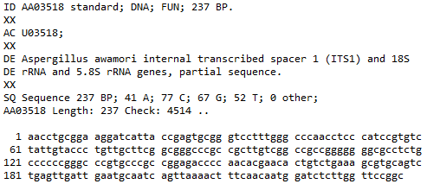
GCG format

Slide 91
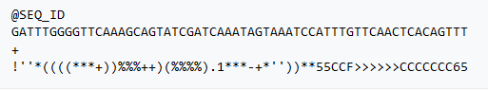
FASTQ format
FASTQ format is a text-based format for storing both a biological sequence (usually nucleotide sequence) and its corresponding quality scores.
Both the sequence letter and quality score are each encoded with a single ASCII character for brevity.
It was originally developed at the Wellcome Trust Sanger Institute to bundle a FASTA formatted sequence and its quality data, but has recently become the de facto standard for storing the output of high-throughput sequencing instruments such as the Illumina Genome Analyzer.

Slide 92
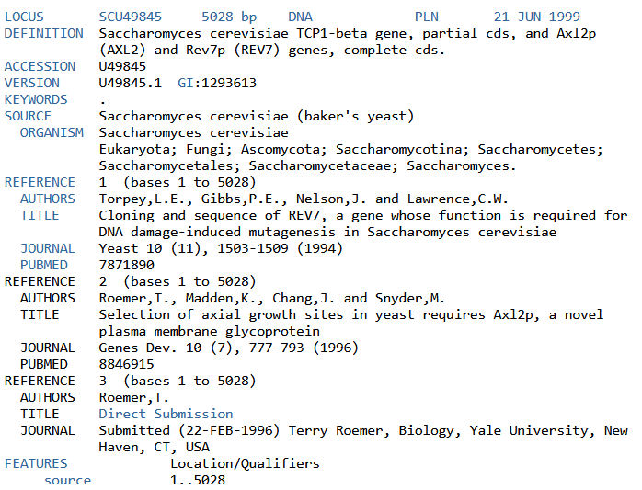
GenBank Flat File Format
https://www.ncbi.nlm.nih.gov/Sitemap/samplerecord.html

Slide 93
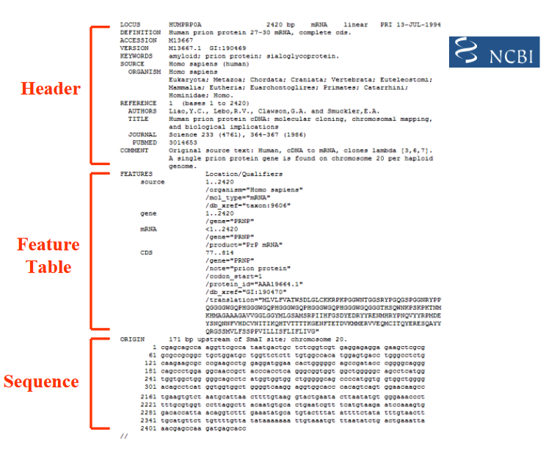
GenBank Flat File Format

Slide 94
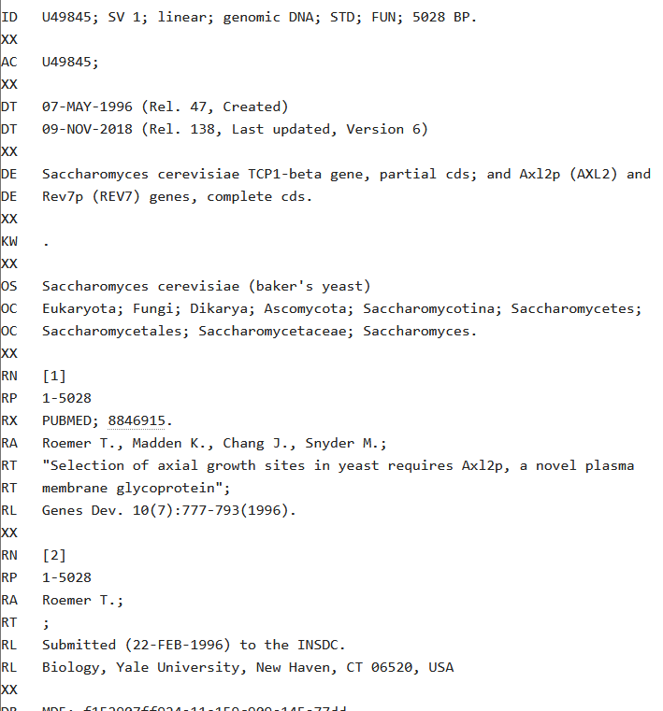
EBI Flat File Format
http://www.ebi.ac.uk/Tools/dbfetch/emblfetch?db=embl&id=U49845

Slide 95
Introduction to Genomics
The term genome was used by German botanist Hans Winker in 1920
Entire genetic component of an organism - GENOME
Collection of genes in haploid set of chromosomes
In 1986 mouse geneticist Thomas Roderick used Genomics for “mapping, sequencing and characterizing genomes”
Genomics is the study of genomes.
Genomic studies are characterized by simultaneous analysis of a large number of genes using automated data gathering tools.
The topics of genomics range from genome mapping, sequencing, and functional genomic analysis to comparative genomic analysis.
The advent of genomics and the ensuing explosion of sequence information are the main driving force behind the rapid development of bioinformatics.
New terms: Functional genomics, transcriptomics, proteomics, metabolomics, phenomics (Omics)

Slide 96
Introduction to Genomics
Genome Sequence can tell us about:
Everything about the organism's life
Its developmental program
Disease resistance or susceptibility
How do we struggle, survive and die?
Where are we going and where we came from?
How similar are we to other species? – Evolutionary History

Slide 97
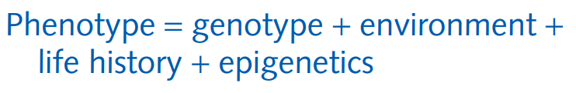
Introduction to Genomics
Your genotype is your DNA sequence, both nuclear and mitochondrial. (For plants, include also the sequence of the chloroplast DNA.)
Your phenotype is the collection of your observable traits, other than your DNA sequence.
These include macroscopic properties such as height, weight, eye and hair colour; and microscopic ones, such as possible sickle-cell anaemia, glucose-6-phosphate deficiency, or the retention beyond infancy of the ability to digest lactose
Of great importance to clinical applications of genomics are traits that govern susceptibility to disease and risk factors; and those that determine the effectiveness of different drugs in different individuals.
These allow for personalized prevention and treatment of disease based on DNA sequences, or pharmacogenomics.

Slide 98
Introduction to Genomics
Your life history includes the integrated total of your experiences, and the physical and psychological environment in which you developed.
Your nutritional history has influenced your physical development.
A nurturing environment and educational opportunities have influenced your mental development.
Less obvious than most aspects of your life history is the growing recognition of the importance of your in utero environment in determining your development curve and even your adult characteristics.

Slide 99
Introduction to Genomics
At the interface between the genome and life experience are epigenetic factors.
It is largely true that all cells of your body, except sperm or egg cells and cells of the immune system, have almost the same DNA sequence (subject to usually modest amounts of accumulated mutations).
Yet your tissues are differentiated, with different sets of genes expressed or silenced in liver, brain, etc.
Some of these regulatory signals survive cell division. (When a liver cell divides, it divides into two liver cells.)
Your parents’ own life histories might have altered the epigenetic patterns in their cells, and the fertilized egg from which you were subsequently formed contained some of these ‘pre-differentiation’ signals.
In this way inheritance of acquired characteristics has re-entered respectable mainstream biology.

Slide 100
Introduction to Genomics
A genome is like a page of printed music.
The page is a fixed physical object, but the notes are consistent with realizations, in time and space, in a variety of ways – a limited variety of ways.
Thus a genome constrains but does not dictate the features of an organism.
Varied surroundings and experience lead organisms to explore different states consistent with their genomes.
Even in microorganisms, expression of many genes is conditional.
Synthesis of enzymes for lactose utilization in E. coli depends on the presence of substrate in the medium.
The shift of yeast between anaerobic and aerobic metabolism is a temporary and reversible change in physiological state in response to changes in environmental conditions.

Slide 101
Introduction to Genomics
Given the variability of the contributions of heredity, environment, life history, and epigenetics in determining phenotype, how can we measure their relative importance for any particular trait?
The classic method of distinguishing effects of genetics from those of surroundings and experience – ‘nature’ and ‘nurture’ – is controlled experiments with genetically identical organisms
For human beings, this means monozygotic twins. (Monozygotic human triplets are extremely rare.)
Many studies have compared the similarities of identical twins reared apart, individuals who have the same genes but different environments.
Less well-controlled are comparisons of identical with fraternal twins, or of non-twin siblings with adopted children reared in the same family.
There have been suggestions that fraternal twins share greater similarity than non-twin siblings as a result of the shared uterine experience.

Slide 102
Functional Genomics
Once we know the sequence of genes, we want to know the function
The genome is the same in all cells of an individual, except for random mutations
However, in each cell, only a subset of the genes is expressed
The portion of the genome that is used in each cell correlates with the cell’s differentiated state
Reverse (Phenotype to Genes) vs Forward Genetics (Genes to Phenotype)

Slide 103
Introduction to Genomics
A human genome contains approximately 3.2 × 10⁹ base pairs, distributed among 22 paired chromosomes, plus two X chromosomes in females and X and Y in males.
The first human genomes were determined in 2001, the culmination of 10 years of pioneering work and dedication.
Since then, advances in technology have made genomic sequencing cheaper and faster.
Sequence data now flow copiously.
This creates the challenges of understanding the information that our genomes contain, and applying the data and analysis to improve human welfare.
Sequencing genomes of other species both facilitates these goals and extends them, by revealing general principles of biology

Slide 104
The Human Genome
The human genome includes: Protein Coding Genes
The most prominent and familiar aspects of the genome, the regions that code for proteins. Protein coding genes are transcribed into messenger RNA (mRNA). After processing, ribosomes translate mature mRNA to polypeptide chains. Despite their importance, protein-coding genes occupy a small fraction of the human genome – no more than about 2–3% of the overall sequence. They are distributed across the different chromosomes, but not evenly. Many protein-coding genes appear in multiple copies, either identical or diverged into families. For instance, humans have over 900 related olfactory-receptor genes, and some animals have many more.

Slide 105
The Human Genome
The human genome includes : Non-Coding RNAs
Some regions of the genome encode non-protein coding RNA molecules (that is, RNAs exclusive of messenger RNAs), including but not limited to transfer RNAs, the RNA components of ribosomes, and microRNAs and small interfering RNAs that regulate translation (miRNAs and siRNAs). There are about 3000 genes coding for RNAs, exclusive of the mRNAs translated to proteins. It is becoming clear that the RNA-ome is much richer than had been suspected. Except for RNAs involved in the machinery of protein synthesis, such as transfer RNAs and the ribosome itself, most non-coding RNAs are involved in control of gene expression. The regions that encode proteins and non-protein coding RNAs correspond to molecules that form non-transient parts of the cell’s contents. They do of course ‘turn over’, but at rates lower than messenger RNAs. mRNAs must have short lifetimes in order to turn off transcription, as part of the processes that regulate gene expression.

Slide 106
The Human Genome
The human genome includes : Regulatory regions
Other regions contain binding sites for ligands responsible for regulation of transcription. In assessing the total amount of the genome dedicated to control, one would need to include both the regulatory sites themselves, and all the proteins and RNAs encoded that have regulatory functions, arguably including receptors
The human genome includes : Repetitive elements
Repetitive elements of unknown function account for surprisingly large fractions of our genomes. Long and Short Interspersed Elements (LINES and SINES) account for 21% and 13% of the genome. Even more-highly repeated sequences – minisatellites and microsatellites – may appear as tens or even hundreds of thousands of copies, in aggregate amounting to 15% of the genome.

Slide 107
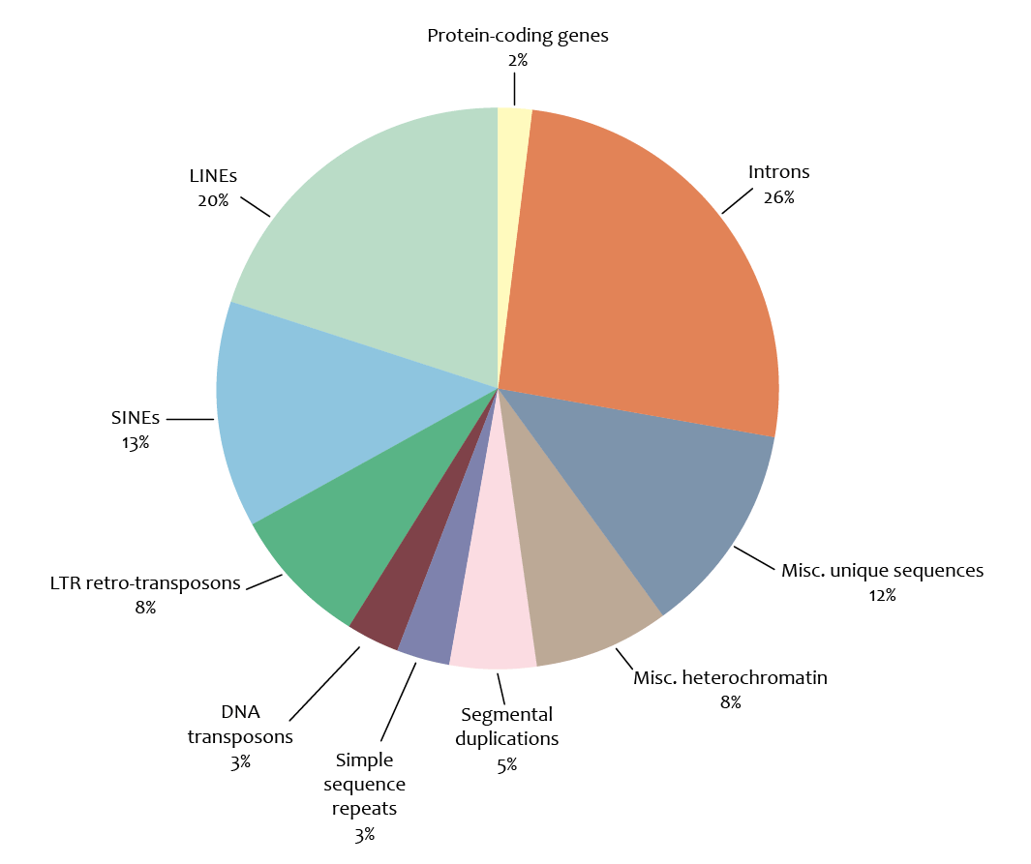

Slide 108
Structural and functional genomics
Genomic study can be tentatively divided into structural genomics and functional genomics.
Structural genomics refers to the initial phase of genome analysis, which includes construction of genetic and physical maps of a genome, identification of genes, annotation of gene features, and comparison of genome structures.
Functional genomics refers to the analysis of global gene expression and gene functions in a genome.

Slide 109
Genome mapping
Genome mapping is an important tool/process for assigning/locating of a specific gene to particular region of a chromosome and determining the location of and relative distances between genes on the chromosome.
Genome mapping is used to identify and record the location of genes and the distances between genes on a chromosome.
A genome map highlights the key ‘landmarks’ in an organism’s genome.
The landmarks on a genome map may include short DNA sequences, regulatory sites that turn genes on and off or the genes themselves.
Genome mapping provided the basis for whole genome sequencing and the Human Genome Project.

Slide 110
Genome mapping
A few years ago, only a handful of ready-made maps of the human genome existed, and these were low-resolution maps of small areas.
Biomedical researchers wishing to localize and clone a disease gene were forced, by and large, to map their region of interest, a time-consuming and painstaking process.
This situation has changed dramatically in recent years, and there are now high-quality genome-wide maps of several different types containing tens of thousands of DNA markers.
With the availability of a finished human sequence, most efforts to construct genomic maps came to a halt; however, integrated maps, genome catalogues, and comprehensive databases linking positional and functional genomic data became even more valuable.
By taking advantage of the available maps and DNA sequence, a researcher can, in many cases, focus in on a candidate region by searching public mapping databases in a matter of hours rather than by performing laboratory experiments over a course of months.

Slide 111
Genome mapping
Different types of genome mapping
There are two distinctive types of "Maps" used in the field of genome mapping: genetic maps and physical maps.
Both maps are a collection of genetic markers and gene loci.
However, genetic maps' distances are based on the genetic linkage information, i.e., how genetic information is shuffled between chromosomes or between different regions in the same chromosome during meiosis.
And physical maps use actual physical distances usually measured in number of base pairs.
While the physical map could be a more "accurate" representation of the genome, genetic maps often offer insights into the nature of different regions of the chromosome.

Slide 112
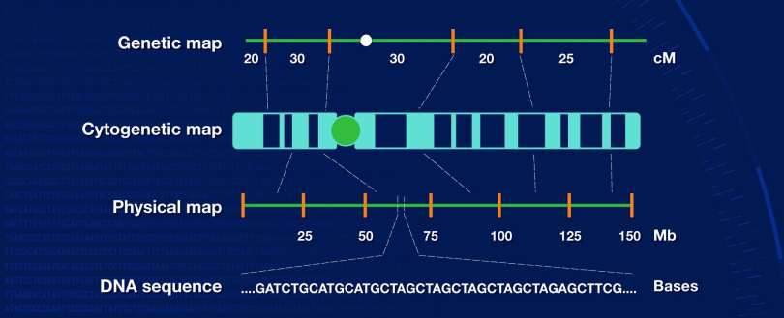
Genome mapping

Slide 113
Genome mapping
Genetic Map
Genetic mapping refers to the determination of the relative positions of genes on a DNA molecule (chromosome or plasmid) and of their distance between them.
Genetic map indicates the position and relative genetic distances between markers along chromosomes.
Genetic mapping uses the Mendelian principles of segregation and recombination to determine the relative proximity of DNA markers along the chromosomes of an organism.
The first genetic map was published in 1911 by T. H. Morgan and his student, Alfred Sturtevant, who showed the locations of 6 sex-linked genes on a fruit fly chromosome.

Slide 114
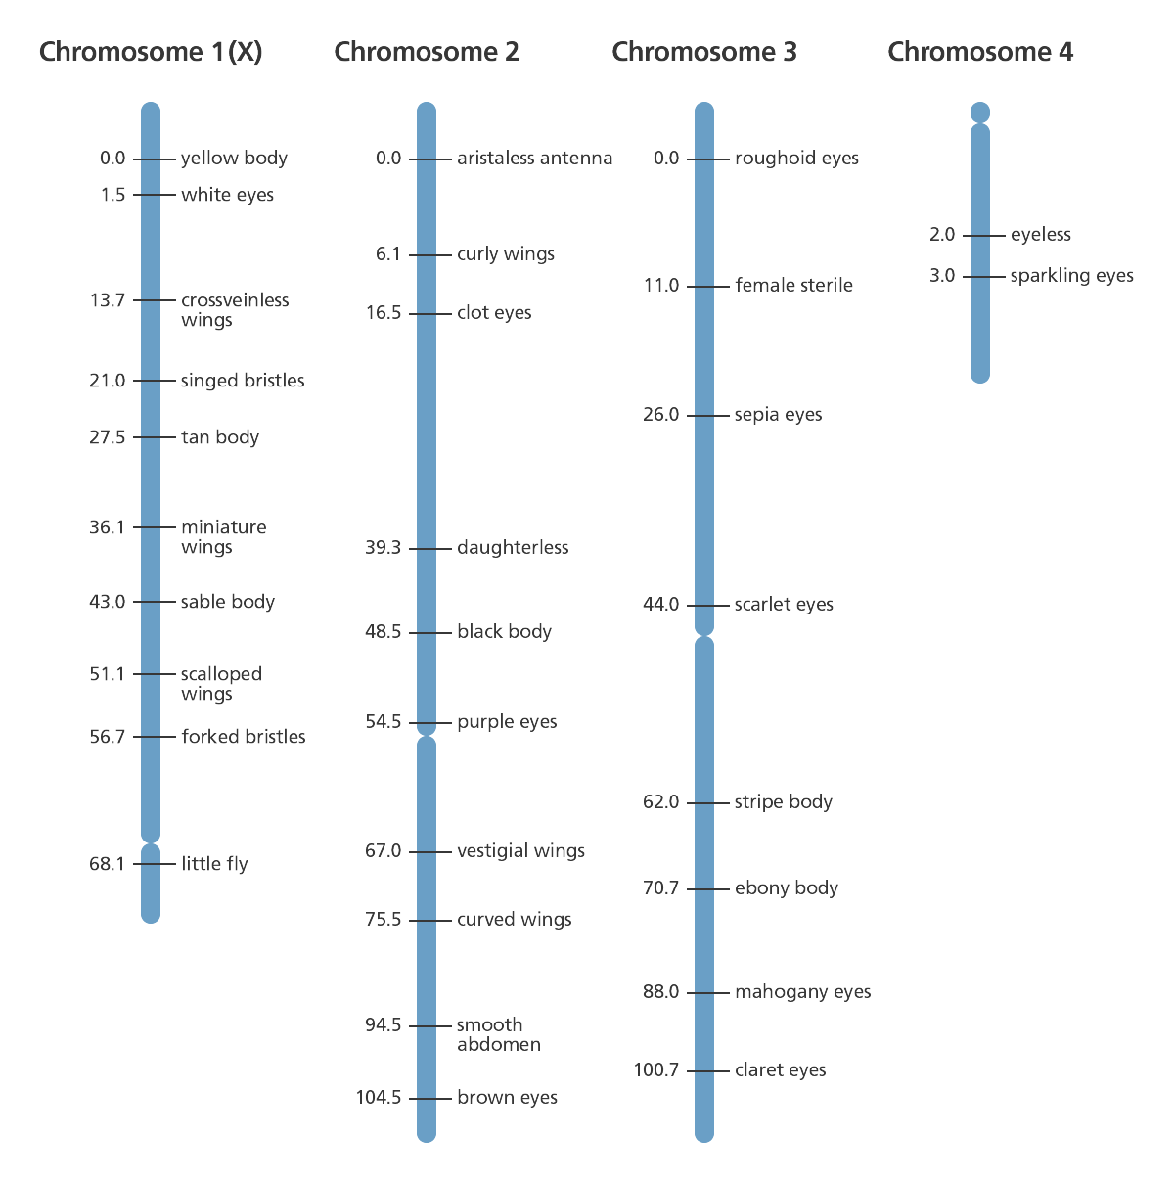
Genome mapping
Genetic Map

Slide 115
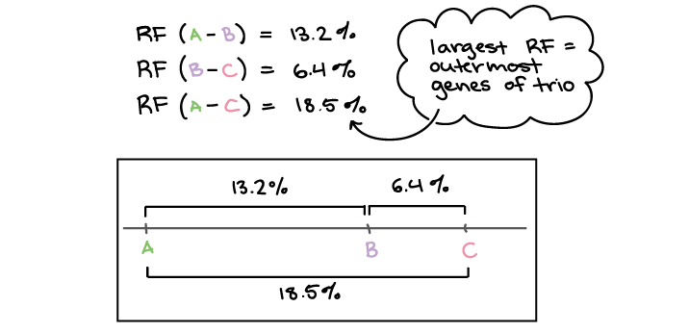
Genome mapping
Genetic Map

Slide 116
Genome mapping
Genetic Map
New markers for better genetic maps.
To produce a genetic map, researchers collect blood or tissue samples from members of a family, some of whom have a certain disease or characteristic.
The researchers then isolate the DNA from samples taken from each individual and closely examine it to find unique patterns in the DNA of those individuals with the disease/characteristic, that aren’t present in the DNA of the individuals who don’t have the disease/characteristic.
These are referred to as markers and are extremely valuable for tracking inheritance of characteristics or diseases through several generations of a family.

Slide 117
Genome mapping
Genetic Map
If a particular gene is close to a DNA marker on the chromosome, it is more likely that the gene and marker will stay together during the recombination process and are therefore more likely to be passed down along the family line (inherited) together.
In the same way, if a DNA marker and gene are frequently separated by the recombination process it suggests that they are far apart on the chromosome and are less likely to be inherited together.
The more DNA markers there are on a genetic map the more likely it is that one of them will be located close to the disease or trait-associated gene.
While genetic maps are good at giving the bigger picture, they have limited accuracy and therefore need to be supplemented with further information gained from other mapping techniques, such as physical mapping.

Slide 118
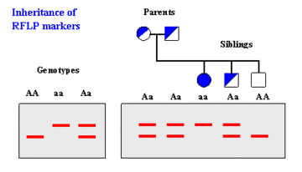
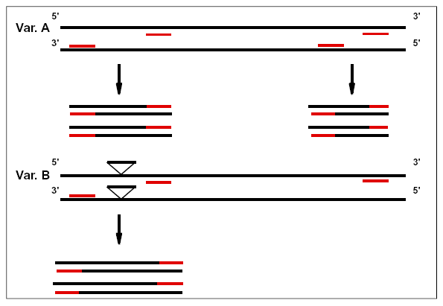
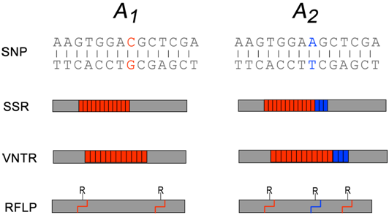
Genome mapping
Genetic Map
Markers used are:
hybridization-based markers :
DNA profiles are visualized by hybridizing to a labeled probe
RFLP : Restriction fragment length polymorphism
polymerase chain reaction (PCR)-based markers :
In vitro amplification of particular DNA sequences
RAPD : Random amplification of polymorphic DNA
Amplified fragment length polymorphism (AFLP)
Simple Sequence Length Polymorphisms (SSLPs)
Minisatellites : Up to 25 bp repeat unit size - SSRs
Microsatellites : 2-6 bp repeat unit size - VNTRs

Slide 119
Genome mapping
Physical Map
Physical mapping gives an estimation of the (physical) distance between specific known DNA sequences on a chromosome.
The distance between these known DNA sequences on a chromosome is expressed as the number of base pairs between them.
There are a several different techniques used for physical mapping.
These include:
Restriction mapping
Fluorescent in situ hybridisation (FISH) mapping
Sequence tagged site (STS) mapping.

Slide 120
Genome mapping
Physical Map
Restriction mapping
This uses specific restriction enzymes to cut an unknown segment of DNA at short, known base sequences called restriction sites.
Restriction enzymes always cut DNA at a specific sequence of DNA (restriction site).
For example, the restriction enzyme EcoRI always cuts at the sequence GAATTC/CTTAAG.
A restriction map shows all the locations of that particular restriction site (GAATTC) throughout the genome.
A physical map is generated by aligning the different restriction maps along the chromosomes.

Slide 121
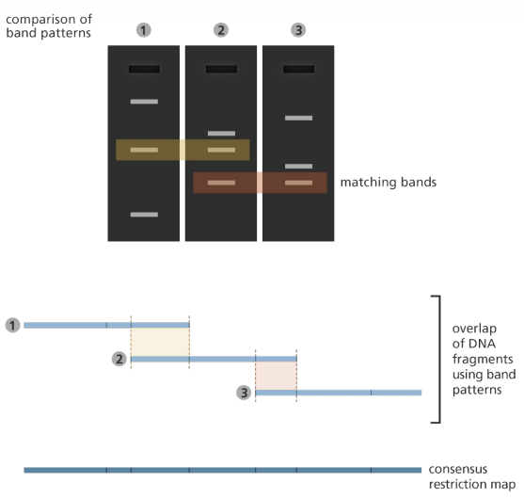
Genome mapping
Physical Map
Fingerprint mapping
In fingerprint mapping the genome is broken into fragments which are then copied in bacterial cells.
The DNA copies (clones) are then cut by restriction enzymes and the lengths of the resulting fragments are estimated through electrophoresis.
A fingerprint map is constructed by comparing the patterns from all the fragments of DNA to find areas of similarity. Those with similar patterns are then grouped together to form a map.
Fingerprint mapping formed the basis to the sequencing of the human, mouse, zebrafish and pig genomes.

Slide 122
Genome mapping
Physical Map
Optical mapping
Optical mapping is a technique for constructing ordered, genome-wide, high-resolution restriction maps from single, stained molecules of DNA, called "optical maps".
Optical mapping uses single molecules of DNA that are stretched and held in place on a slide.
Restriction enzymes are added to cut the DNA at specific points leaving gaps behind.
The fragments are then stained with dye and the gaps are visualized under a fluorescence microscope.
The intensity of the fluorescence is used to construct an optical map of single molecules.
These can then be combined and overlapped to give a global overview of the genome and aid with assembling a sequenced genome.

Slide 123
Genome mapping
Physical Map
Optical mapping
Genomic DNA is obtained from lysed cells, and randomly sheared to produce a "library" of large genomic molecules for optical mapping.
A single molecule of DNA is stretched (or elongated) and held in place on a slide under a fluorescent microscope due to charge interactions.
The DNA molecule is digested by added restriction enzymes, which cleave at specific digestion sites. The resulting molecule fragments remain attached to the surface. The fragment ends at the cleavage sites are drawn back (due to elasticity of linearized DNA), leaving gaps which are identifiable under the microscope.
DNA fragments stained with intercalating dye are visualized by fluorescence microscopy and are sized by measuring the integrated fluorescence intensity. This produces an optical map of single molecules.
Individual optical maps are combined to produce a consensus, genomic optical map.

Slide 124
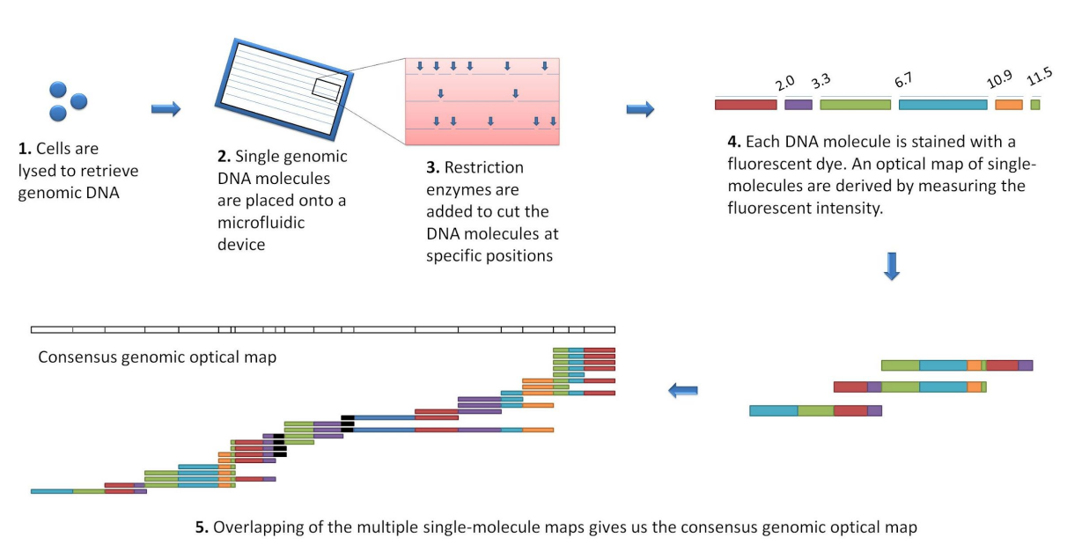
Genome mapping
Physical Map
Optical mapping

Slide 125
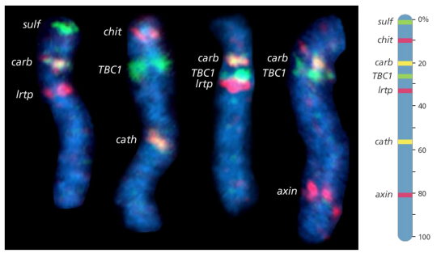
Genome mapping
Physical Map
Fluorescent in situ hybridisation (FISH) mapping
This uses fluorescent probes to detect the location of DNA sequences on chromosomes.
First, the probes are prepared.
These are short sequences of single-stranded DNA, that match the DNA sequence that the scientist wants to find.
The probes are then labelled with fluorescent dye before being mixed with the chromosome DNA so that it can bind to a complementary strand of DNA on the chromosome.
The fluorescent tag allows the scientist to see the location of the DNA sequence on the chromosome.

Slide 126
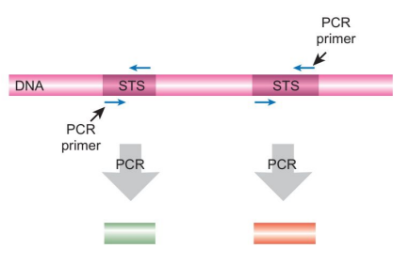
Genome mapping
Physical Map
Sequence-tagged site (STS) mapping
A sequence-tagged site (or STS) is a short (200 to 500 base pair) DNA sequence that has a single occurrence in the genome and whose location and base sequence are known.
STSs can be easily detected by the polymerase chain reaction (PCR) using specific primers.
For this reason they are useful for constructing genetic and physical maps from sequence data reported from many different laboratories.
They serve as landmarks on the developing physical map of a genome.
When STS loci contain genetic polymorphisms (e.g. simple sequence length polymorphisms, SSLPs, single nucleotide polymorphisms), they become valuable genetic markers, i.e. loci which can be used to distinguish individuals.
They are used in shotgun sequencing, specifically to aid sequence assembly.

Slide 127
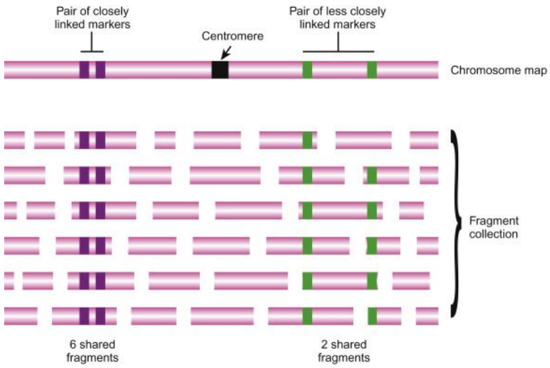
Genome mapping
Physical Map
Sequence-tagged site (STS) mapping
STS mapping is shown for four STS sites on a single chromosome.
A variety of restriction enzyme digests are performed to cut the chromosome into fragments of many different sizes.
The number of times two STS sequences are found on the same fragment reveals how close the two markers are to each other.
In this example, the two purple STSs are found on the same fragment six times and must be close to each other on the chromosome.
The two green STSs are only found on the same fragment two times and are therefore further apart.

Slide 128
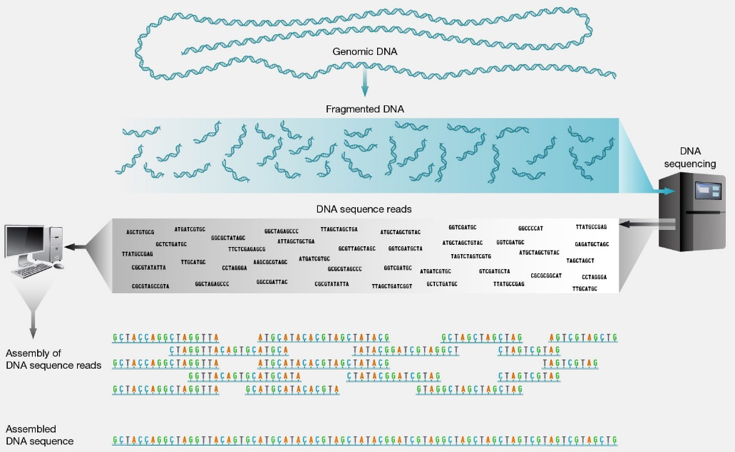
Genome mapping
Physical Map
Genome sequencing
The highest resolution genome map is the genomic DNA sequence that can be considered as a type of physical map describing a genome at the single base-pair level.
The shotgun approach
Shotgun sequencing is a laboratory technique for determining the DNA sequence of an organism's genome.
The method involves randomly breaking up the genome into small DNA fragments that are sequenced individually.

Slide 129
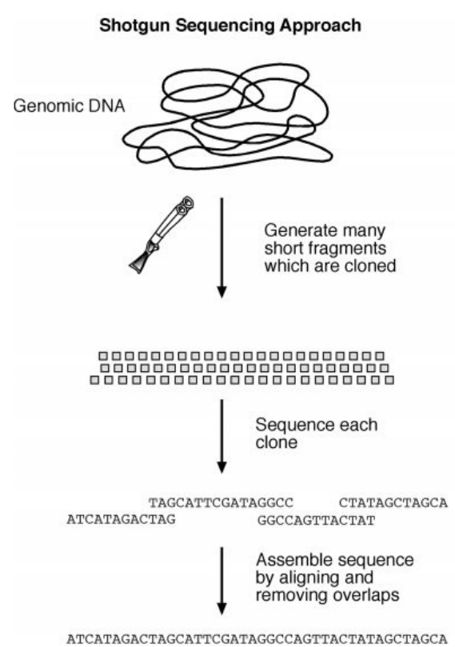
Genome mapping
Physical Map
Genome sequencing
The shotgun approach
The shotgun approach randomly sequences clones from both ends of cloned DNA.
This approach generates a large number of sequenced DNA fragments.
The number of random fragments has to be very large, so large that the DNA fragments overlap sufficiently to cover the entire genome.
This approach does not require knowledge of physical mapping of the clone fragments, but rather a robust computer assembly program to join the pieces of random fragments into a single, whole-genome sequence.
Generally, the genome has to be redundantly sequenced in such a way that the overall length of the fragments covers the entire genome multiple times.
This is designed to minimize sequencing errors and ensure correct assembly of a contiguous sequence.
Overlapping sequences with an overall length of six to ten times the genome size are normally obtained for this purpose.

Slide 130
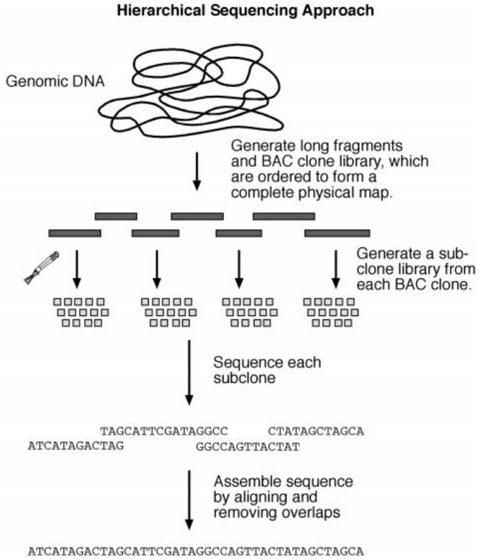
Genome mapping
Physical Map
Genome sequencing
Hierarchical genome sequencing
The hierarchical genome sequencing approach is similar to the shotgun approach, but on a smaller scale.
The chromosomes are initially mapped using the physical mapping strategy.
Longer fragments of genomic DNA (100 to 300 kB) are obtained and cloned into a high-capacity bacterial vector called bacterial artificial chromosome (BAC).
Based on the results of physical mapping, the locations and orders of the BAC clones on a chromosome can be determined.
By successively sequencing adjacent BAC clone fragments, the entire genome can be covered.
The complete sequence of each individual BAC clone can be obtained using the shotgun approach.
Overlapping BAC clones are subsequently assembled into an entire genome sequence.

Slide 131
Genome mapping
Physical Map
Pros and cons
During the era of human genome sequencing, there was a heated debate on the merits of each of the two strategies.
In fact, there are advantages and disadvantages in either.
The hierarchical approach is slower and more costly than the shotgun approach because it involves an initial clone-based physical mapping step.
However, once the map is generated, assembly of the whole genome becomes relatively easy and less error prone.
In contrast, the whole genome shotgun approach can produce a draft sequence very rapidly because it is based on the direct sequencing approach.
However, it is computationally very demanding to assemble the short random fragments.
Although the approach has been successfully employed in sequencing small microbial genomes, for a complex eukaryotic genome that contains high levels of repetitive sequences, such as the human genome, the full shotgun approach becomes less accurate and tends to leave more “holes” in the final assembled sequence than the hierarchical approach.
Current genome sequencing of large organisms often uses a combination of both approaches.

Slide 132
Genome mapping
Genome sequence assembly
Initial DNA sequencing reactions generate short sequence reads from DNA clones.
The average length of the reads is about 500 bases.
To assemble a whole genome sequence, these short fragments are joined to form larger fragments after removing overlaps.
These longer, merged sequences are termed contigs, which are usually 5,000 to 10,000 bases long.
A number of overlapping contigs can be further merged to form scaffolds (30,000–50,000 bases, also called supercontigs), which are unidirectionally oriented along a physical map of a chromosome.
Overlapping scaffolds are then connected to create the final highest resolution map of the genome.

Slide 133
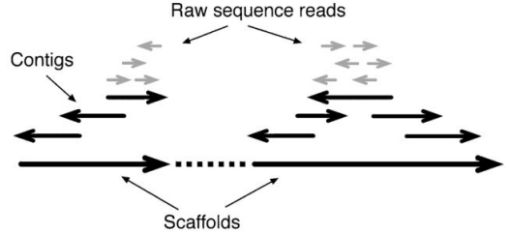
Genome mapping
Genome sequence assembly
Schematic diagram showing three different levels of sequence assembly.
Contigs are formed by combining raw sequence reads of various orientations after removing overlaps.
Scaffolds are assembled from contigs and oriented unidirectionally on a chromosome.
Because sequence fragments generated can be in either of the DNA strands, arrows are used to represent directionality of the sequences written in 5' → 3' orientation.

Slide 134
Genome mapping
Genome sequence assembly
Correct identification of overlaps and assembly of the sequence reads into contigs are like joining jigsaw puzzles, which can be very computationally intensive when dealing with data at the whole-genome level.
The major challenges in genome assembly are sequence errors, contamination by bacterial vectors, and repetitive sequence regions.
Sequence errors can often be corrected by drawing a consensus from an alignment of multiple overlapped sequences.
Bacterial vector sequences can be removed using filtering programs prior to assembly.

Slide 135
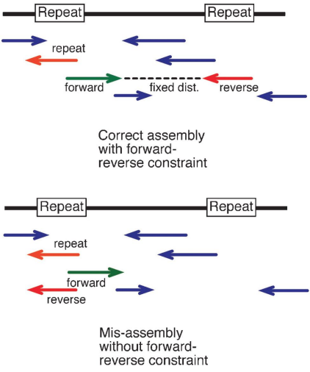
Genome mapping
Genome sequence assembly
A commonly used constraint to avoid errors caused by sequence repeats is the so called forward–reverse constraint.
When a sequence is generated from both ends of a single clone, the distance between the two opposing fragments of a clone is fixed to a certain range, meaning that they are always separated by a distance defined by a clone length (normally 1,000 to 9,000 bases).
When the constraint is applied, even when one of the fragments has a perfect match with a repetitive element outside the range, it is not able to be moved to that location to cause miss-assembly.

Slide 136
Genome mapping
Base Calling and Assembly Programs
The first step toward genome assembly is to derive base calls and assign associated quality scores.
The next step is to assemble the sequence reads into contiguous sequences.
This step includes identifying overlaps between sequence fragments, assigning the order of the fragments and deriving a consensus of an overall sequence.
Assembling all shotgun fragments into a full genome is a computationally very challenging step.
There are a variety of programs available for processing the raw sequence data.

Slide 137
Genome mapping
Base Calling and Assembly Programs
Phred (www.phrap.org/) is a UNIX program for base calling.
It uses a Fourier analysis to resolve fluorescence traces and predict actual peak locations of bases.
It also gives a probability score for each base call that may be attributable to error.
The commonly accepted score threshold is twenty, which corresponds to a 1% chance of error.
The higher the score, the better the quality of the sequence reads.
If the score value falls below the threshold, human intervention is required.

Slide 138
Genome mapping
Base Calling and Assembly Programs
Phrap (www.phrap.org/) is a UNIX program for sequence assembly.
It takes Phred base-call files with quality scores as input and aligns individual fragments in a pairwise fashion using the Smith–Waterman algorithm.
The base quality information is taken into account during the pairwise alignment.
After all the pairwise sequence similarity is identified, the program performs assembly by progressively merging sequence pairs with decreasing similarity scores while removing overlapped regions.
Consensus contigs are derived after joining all possible overlapped reads.

Slide 139
Genome annotation
Once a genome is sequenced, it needs to be annotated to make sense of it.
Genome annotation is the process of attaching biological information to sequences.
The unknown sequence is enriched with information relating genomic position to intron-exon boundaries, regulatory sequences, repeats, gene names and protein products.
Genome annotation consists of three main steps:
Identifying portions of the genome that do not code for proteins
Identifying elements on the genome, a process called gene prediction
Attaching biological information to these elements
Automatic annotation tools attempt to perform these steps via computer analysis, as opposed to manual annotation (a.k.a. curation) which involves human expertise.
Ideally, these approaches co-exist and complement each other in the same annotation pipeline.

Slide 140
Genome annotation
A simple method of gene annotation relies on homology based search tools, like BLAST, to search for homologous genes in specific databases, the resulting information is then used to annotate genes and genomes.
However, as information is added to the annotation platform, manual annotators become capable of deconvoluting discrepancies between genes that are given the same annotation.
Some databases use genome context information, similarity scores, experimental data, and integrations of other resources to provide genome annotations through their Subsystems approach.
Other databases (e.g. Ensembl) rely on curated data sources as well as a range of different software tools in their automated genome annotation pipeline.

Slide 141
Genome annotation
Structural and functional annotation
There are two interrelated types of genomic annotation: structural and functional.
Structural annotation consists of the identification of genomic elements.
ORFs and their localization
Gene structure
Coding regions
Location of regulatory motifs
Functional annotation consists of attaching biological information to genomic elements.
Biochemical function
Biological function
Involved regulation and interactions
Expression
These steps may involve both biological experiments and in silico analysis.

Slide 142
Genome annotation
Comparative genomics
Comparison of whole genomes from different organisms is comparative genomics, which includes comparison of gene number, gene location, and gene content from these genomes.
The comparison helps to reveal the extent of conservation among genomes, which will provide insights into the mechanism of genome evolution and gene transfer among genomes.
It helps to understand the pattern of acquisition of foreign genes through lateral gene transfer.
It also helps to reveal the core set of genes common among different genomes, which should correspond to the genes that are crucial for survival.
This knowledge can be potentially useful in future metabolic pathway engineering.
The main themes of comparative genomics include whole genome alignment, comparing gene order between genomes, constructing minimal genomes, and lateral gene transfer among genomes.

Slide 143
Genome annotation
Whole genome alignment
With an ever-increasing number of genome sequences available, it becomes imperative to understand sequence conservation between genomes, which often helps to reveal the presence of conserved functional elements.
This can be accomplished through direct genome comparison or genome alignment.
The alignment at the genome level is fundamentally no different from the basic sequence alignment
However, alignment of extremely large sequences presents new complexities owing to the sheer size of the sequences.
Regular alignment programs tend to be error prone and inefficient when dealing with long stretches of DNA containing hundreds or thousands of genes.
Another challenge of genome alignment is effective visualization of alignment results.

Slide 144
Genome annotation
Finding the minimal genome
One of the goals of genome comparison is to understand what constitutes a minimal genome, which is a minimal set of genes required for maintaining a free-living cellular organism.
Finding minimal genomes helps provide an understanding of genes constituting key metabolic pathways, which are critical for a cell’s survival.
This analysis involves identification of orthologous genes shared between a number of divergent genomes.

Slide 145
Genome annotation
Lateral gene transfer
Lateral gene transfer (or horizontal gene transfer) is defined as the exchange of genetic materials between species in a way that is incongruent with commonly accepted vertical evolutionary pathway.
If lateral transfer events occurred relatively recently, one would expect to discover traces of the transfer by detecting regions of genomic sequence with unusual properties compared to surrounding regions.
The unusual characteristics to be examined include nucleotide composition, codon usage, and amino acid composition.
This can be considered a “within-genome” approach.
Another way to discern lateral gene transfer is through phylogenetic analysis referred to as an “among-genome” approach, which can be used to discover both recent and ancient lateral gene transfer events.

Slide 146
Functional genomics
Functional genomics deals with experiment based with a focus on gene functions at the whole genome level using high throughput approaches.
The emphasis here is on “high throughput,” which is simultaneous analysis of all genes in a genome.
This feature is in fact what separates genomics from traditional molecular biology, which studies only one gene at a time.
The high throughput analysis of all expressed genes is also termed transcriptome analysis, which is the expression analysis of the full set of RNA molecules produced by a cell under a given set of conditions.
Transcriptome analysis facilitates our understanding of how sets of genes work together to form metabolic, regulatory, and signaling pathways within the cell.
It reveals patterns of coexpressed and coregulated genes and allows determination of the functions of genes that were previously uncharacterized.
In short, functional genomics provides insight into the biological functions of the whole genome through automated high throughput expression analysis.
Transcriptome analysis that can be conducted using either sequence- or microarray-based approaches.

Slide 147
Functional genomics
Sequence based approach: Expressed sequence tags
One of the high throughput approaches to genome-wide profiling of gene expression is sequencing expressed sequence tags (ESTs).
ESTs are short sequences obtained from cDNA clones and serve as short identifiers of full-length genes.
ESTs are typically in the range of 200 to 400 nucleotides in length obtained from either the 5 end or 3 end of cDNA inserts.
Libraries of cDNA clones are prepared through reverse transcription of isolated mRNA populations by using oligo(dT) primers that hybridize with the poly(A) tail of mRNAs and ligation of the cDNAs to cloning vectors.
To generate EST data, clones in the cDNA library are randomly selected for sequencing from either end of the inserts.

Slide 148
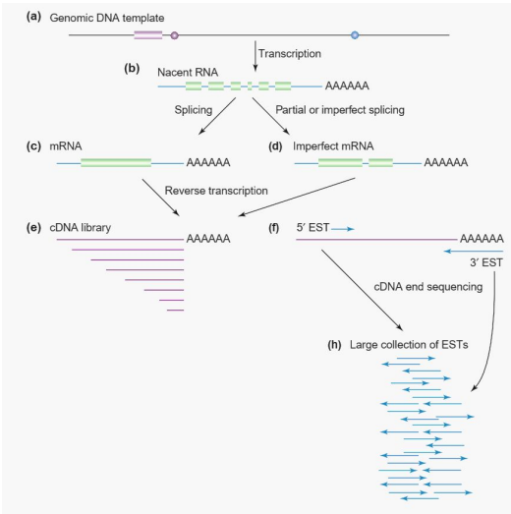
Functional genomics
Expressed sequence tags
RNAs prepared from cellular material are a complex mixture and both mRNAs and imperfect mRNAs.
A cDNA population is reverse transcribed from the RNA population.
The 3' poly-A tail is used as a selective tag for mRNA selection and so the 3' end of the genes are more likely to be represented within the cDNA libraries than the 5' ends.
DNA sequence is read from the ends of the cDNA, yielding 5' and 3' ESTs.
These sequences join the pools of available ESTs for this organism.

Slide 149
Functional genomics
Expressed sequence tags : Advantages
The EST data are able to provide a rough estimate of genes that are actively expressed in a genome under a particular physiological condition.
This is because the frequencies for particular ESTs reflect the abundance of the corresponding mRNA in a cell, which corresponds to the levels of gene expression at that condition.
Another potential benefit of EST sampling is that, by randomly sequencing cDNA clones, it is possible to discover new genes.
EST libraries can be easily generated from various cell lines, tissues, organs, and at various developmental stages.
ESTs can also facilitate the unique identification of a gene from a cDNA library; a short tag can lead to a cDNA clone.
Although individual ESTs are prone to error, an entire collection of ESTs contains valuable information.
Often, after consolidation of multiple EST sequences, a full-length cDNA can be derived.
By searching a nonredundant EST collection, one can identify potential genes of interest.

Slide 150
Functional genomics
Expressed sequence tags : Limitations
EST sequences are often of low quality because they are automatically generated without verification and thus contain high error rates.
Many bases are ambiguously determined, represented by N ’s.
Common errors also include frameshift errors and artifactual stop codons, resulting in failures of translating the sequences.
In addition, there is often contamination by vector sequence, introns (from unspliced RNAs), ribosomal RNA (rRNA), mitochondrial RNA, among others.
ESTs represent only partial sequences of genes. Gene sequences at the 3 end tend to be more heavily represented than those at the 5 end because reverse transcription is primed with oligo(dT) primers.
Another problem of ESTs is the presence of chimeric clones owing to cloning artifacts in library construction, in which more than one transcript is ligated in a clone resulting in the 5 end of a sequence representing one gene and the 3 end another gene.
Another fundamental problem with EST profiling is that it predominantly represents highly expressed, abundant transcripts. Weakly expressed genes are hardly found in a EST sequencing survey.

Slide 151
Functional genomics
Serial analysis of gene expression (SAGE)
Serial analysis of gene expression (SAGE) is another high throughput, sequence-based approach for global gene expression profile analysis.
Unlike EST sampling, SAGE is more quantitative in determining mRNA expression in a cell.
In this method, short fragments of DNA (usually 15 base pairs) are excised from cDNA sequences and used as unique markers of the gene transcripts.
The sequence fragments are termed tags.
They are subsequently concatenated (linked together), cloned, and sequenced. The transcript analysis is carried out computationally in a serial manner.
Once gene tags are unambiguously identified, their frequency indicates the level of gene expression.
This approach is much more efficient than the EST analysis in that it uses a short nucleotide tag to define a gene transcript and allows sequencing of multiple tags in a single clone.

Slide 152

Functional genomics
Serial analysis of gene expression (SAGE)
Isolate the mRNA of an input sample (e.g. a tumor).
Extract a small chunk of sequence from a defined position of each mRNA molecule.
Link these small pieces of sequence together to form a long chain (or concatemer).
Clone these chains into a vector which can be taken up by bacteria.
Sequence these chains using modern high-throughput DNA sequencers.
Process this data with a computer to count the small sequence tags.

Slide 153
Functional genomics
Microarray based approach
The most commonly used global gene expression profiling method in current genomics research is the DNA microarray-based approach.
A microarray (or gene chip) is a slide attached with a high-density array of immobilized DNA oligomers representing the entire genome of the species under study.
Each oligomer is spotted on the slide and serves as a probe for binding to a unique, complementary cDNA.
The entire cDNA population, labeled with fluorescent dyes or radioisotopes, is allowed to hybridize with the oligo probes on the chip.
The amount of fluorescent or radiolabels at each spot position reflects the amount of corresponding mRNA in the cell.
Using this analysis, patterns of global gene expression in a cell can be examined.
Sets of genes involved in the same regulatory or metabolic pathways can potentially be identified.

Slide 154

Functional genomics
DNA microarray analysis
A typical DNA microarray experiment involves a multistep procedure:
fabrication of microarrays by fixing properly designed oligonucleotides representing specific genes;
hybridization of cDNA populations onto the microarray;
scanning hybridization signals and image analysis;
transformation and normalization of data;
analyzing data to identify differentially expressed genes as well as sets of genes that are coregulated

Slide 155
The Human Genome Project
The Human Genome Project (HGP) was an international scientific research project with the goal of determining the base pairs that make up human DNA, and of identifying and mapping all of the genes of the human genome from both a physical and a functional standpoint.
It remains the world's largest collaborative biological project.
This $3 billion project was a 13-year-long, publicly funded project initiated in 1990 with the objective of determining the DNA sequence of the entire euchromatic human genome within 15 years

Slide 156
The Human Genome Project
Most of the government-sponsored sequencing was performed in twenty universities and research centres in the United States, the United Kingdom, Japan, France, Germany, Spain, and China.
A parallel project was conducted outside the government by the Celera Corporation, or Celera Genomics, which was formally launched in 1998
In 1990, the two major funding agencies, DOE and NIH, developed a memorandum of understanding in order to coordinate plans and set the clock for the initiation of the Project to 1990.

Slide 157
The Human Genome Project
During the project’s initiation, David Galas was Director of the “Office of Biological and Environmental Research” in the U.S. Department of Energy's Office of Science and James Watson headed the NIH Genome Program.
In 1993, Aristides Patrinos succeeded Galas and Francis Collins succeeded James Watson, assuming the role of overall Project Head as Director of the U.S. National Institutes of Health (NIH) National Center for Human Genome Research

Slide 158
The Human Genome Project
The Human Genome Project (HGP) was declared complete in April 2003.
An initial rough draft of the human genome was available in June 2000 and by February 2001 a working draft had been completed and published followed by the final sequencing mapping of the human genome on April, 2003.
Although this was reported to cover 99% of the euchromatic human genome with 99.99% accuracy, a major quality assessment of the human genome sequence was published on May, 2004 indicating over 92% of sampling exceeded 99.99% accuracy which was within the intended goal

Slide 159
The Human Genome Project
In March 2009, the Genome Reference Consortium (GRC) released a more accurate version of the human genome, but that still left more than 300 gaps, while 160 such gaps remained in 2015.
Though in May 2020, the GRC reported 79 "unresolved" gaps, accounting for as much as 5% of the human genome,
The application of new long-range sequencing techniques and a homozygous cell line led to the first telomere-to-telomere, truly complete sequence of a human chromosome, the X-chromosome.
Work to complete the remaining chromosomes using the same approach is ongoing.

Slide 160
The Human Genome Project
Based on the insights gained from the yeast and worm studies, the Human Genome Project employed a two-phase approach to tackle the human genome sequence.
The first phase, called the shotgun phase, divided human chromosomes into DNA segments of an appropriate size, which were then further subdivided into smaller, overlapping DNA fragments that were sequenced.
The Human Genome Project relied upon the physical map of the human genome established earlier, which served as a platform for generating and analyzing the massive amounts of DNA sequence data that emerged from the shotgun phase.
Next, the second phase of the project, called the finishing phase, involved filling in gaps and resolving DNA sequences in ambiguous areas not obtained during the shotgun phase.

Slide 161

The Human Genome Project
The shotgun phase of the Human Genome Project itself consisted of three steps:
Obtaining a DNA clone to sequence
Sequencing the DNA clone
Assembling sequence data from multiple clones to determine overlap and establish a contiguous sequence

Slide 162
The Human Genome Project
The approach used by the members of the IHGSC (International Human Genome Sequencing Consortium) was called the hierarchical shotgun method, because the team members systematically generated overlapping clones mapped to individual human chromosomes, which were individually sequenced using a shotgun approach.

Slide 163
The Human Genome Project
The clones were derived from DNA libraries made by ligating DNA fragments generated by partial restriction enzyme digestion of genomic DNA from anonymous human donors into bacterial artificial chromosome vectors, which could be propagated in bacteria.

Slide 164
The Human Genome Project
When possible, the DNA fragments within the library vectors were mapped to chromosomal regions by screening for sequence-tagged sites (STSs), which are DNA fragments, usually less than 500 base pairs in length, of known sequence and chromosomal location that can be amplified using polymerase chain reaction (PCR).

Slide 165
The Human Genome Project
Library clones were also digested with the restriction enzyme HindIII, and the sizes of the resulting DNA fragments were determined using agarose gel electrophoresis.
Each library clone exhibited a DNA fragment "fingerprint," which could be compared to that of all other library clones in order to identify overlapping clones.

Slide 166
The Human Genome Project
Fluorescence in situ hybridization (FISH) was also used to map library clones to specific chromosomal regions.
Collectively, the STS, DNA fingerprint, and FISH data allowed the IHGSC to generate contigs, which consisted of multiple overlapping bacterial artificial chromosome (BAC) library clones spanning each of the 24 different human chromosomes (i.e., 22 autosomes and the X and Y chromosomes).

Slide 167

The Human Genome Project
Next, individual BAC clones selected for DNA sequence analysis were further fragmented, and the smaller genomic DNA fragments were subcloned into vectors to generate a BAC-derived shotgun library.
The inserts were sequenced using primers matching the vector sequence flanking the genomic DNA insert, and overlapping shotgun clones were used to generate a DNA sequence spanning the entire BAC clone

Slide 168
The Human Genome Project
The members of the IHGSC agreed that each center would obtain an average of fourfold sequence coverage, with no clone having less than threefold coverage.
The term "shotgun" comes from the fact that the original BAC clone was randomly fragmented and sequenced, and the raw DNA sequence data was then subjected to computational analyses to generate an ordered set of DNA sequences that spanned the BAC clone.

Slide 169
The Human Genome Project
After the completion of the draft phase of the Human Genome Project, the IHGSC pursued the second phase of the project: the finishing phase.
During this phase, the researchers filled in gaps and resolved DNA sequences in ambiguous areas that were not solved during the shotgun phase.
The finishing phase yielded 99% of the human genome in final form. The final form of the human genome contained 2.85 billion nucleotides, with a predicted error rate of 1 event per 100,000 bases sequenced.

Slide 170
The Human Genome Project
Key findings of the draft (2001) and complete (2004) genome sequences include:
There are approximately 22,300 protein-coding genes in human beings, the same range as in other mammals.
The human genome has significantly more segmental duplications (nearly identical, repeated sections of DNA) than had been previously suspected.
At the time when the draft sequence was published, fewer than 7% of protein families appeared to be vertebrate specific

Slide 171
The Human Genome Project
The sequencing of the human genome holds benefits for many fields, from molecular medicine to human evolution.
The Human Genome Project, through its sequencing of the DNA, can help us understand diseases including:
genotyping of specific viruses to direct appropriate treatment;
identification of mutations linked to different forms of cancer;
the design of medication and more accurate prediction of their effects;
advancement in forensic applied sciences;
bioarcheology, anthropology and evolution.
development of genomics research related to DNA based products, a multibillion-dollar industry.

Slide 172
Thank you
Roji Raut
9840076094
rojirautofficial@gmail.com

